Slide 1

2015 IACREOT Annual Conference
Vail, CO - June 27, 2015 webSCORE: Colorado’s Real-time, Statewide
Electronic Poll Book
Dwight Shellman, County Support Manager
Colorado Secretary of State, Elections Division

Slide 2
Colorado’s Election Model
HB 13-1303 was enacted in 2013:
Replaced 30-day precinct residency requirement with 22-day state residency requirement
Requires counties to send mail ballots to all active voters
Adopted same-day voter registration

Slide 3
Colorado’s Hybrid Election Model (continued)
Same-day voter registration means there always will be a population of eligible voters that cannot timely receive a mail ballot
As a result, in-person voting options must remain available
HB 13-1303 requires counties to establish minimum numbers of Voter Service and Polling Centers, which must operate for 15 days before General Elections and 8 days before other elections

Slide 4
Colorado’s Hybrid Election Model (continued)
HB 13-1303 requires VSPCs to permit eligible individuals to:
Register to vote if not yet registered in Colorado
Update or change an existing voter registration record
Vote in-person, if desired, on the ballot style for which they are eligible as determined by their residence
Obtain an original or replacement mail ballot of the proper style, if desired
Vote on accessible voting equipment

Slide 5
Colorado’s Hybrid Election Model (continued)
All of this means:
Voter registrations are extremely dynamic:
  Voter registrations are 100% portable in Colorado
  Voters can move within their county at any time – affects ballot style eligibility
  Voters can move from one county to another at any time
Election officials and judges must be able to work real-time in the statewide voter registration database

Slide 6
Colorado’s Statewide Voter Registration Database
Legacy system is a Citrix-based platform that requires users to open and close specific modules depending on the work they need to perform
Legacy system was chiefly designed for use by election staff, not citizen judges
Existing modules did not work well under the new model

Slide 7
Efforts to Find an Existing ePoll Book Solution
Issued Request for Proposals in November 2013
Received ~10 responses
Product offerings had many great features
But none of them offered real-time data exchange with voter registration system
Ultimately declared “No Award,” and decided to develop internally
The Business Practices Group of the COVAME Commission created by HB 1303 identified many requirements and the need for a simple, usable solution

Slide 8
Close collaboration with county users
Conducted three joint application development sessions (JADs), which county users attended in person or remotely
Each JAD demonstrated functionality of particular development sprints
Counties provided feedback and criticisms during JADs
Counties insisted on simplicity and intuitiveness
Each JAD was followed by separate conference calls with small, medium and large counties, so that all users felt free to describe their particular needs

Slide 9
Phases of Development
Phase I focused on developing all functionality required at VSPCs, except:
New registrations of individuals not yet registered
Editing “keyline” information in existing records (name, DOB, gender, ID numbers)
Counties could perform these functions in the Citrix-based application, not the web services application
Phase I went live for 2014 General Election

Slide 10
Phases of Development (continued)
Phase II adds the ability to register new voters and edit keyline information to the web application
Phase II is being released soon for User Acceptance Testing (UAT) by counties, and will be available for statewide mock election in August
Phase II will go live for the November 2015 Coordinated Election

Slide 11
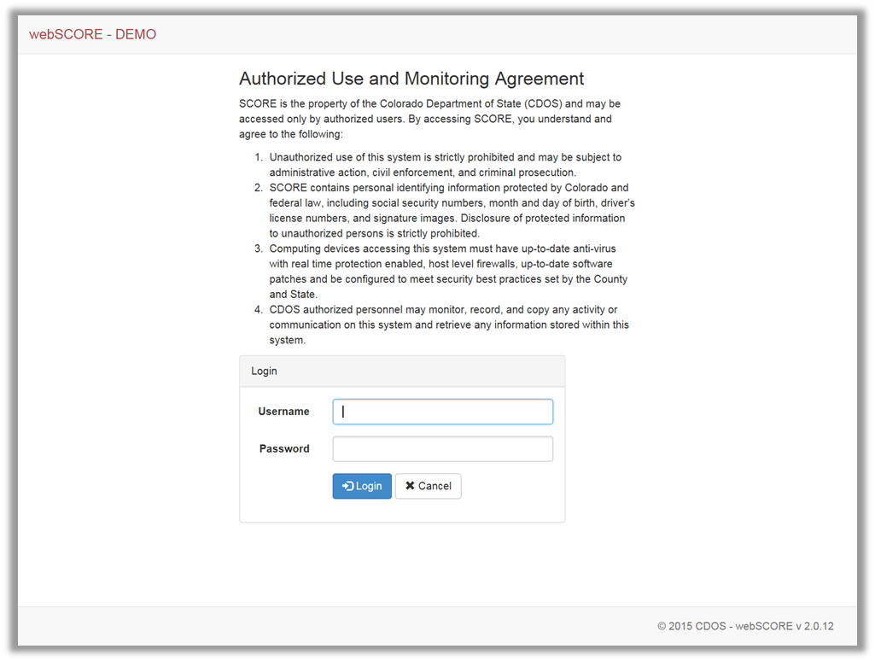

Slide 12
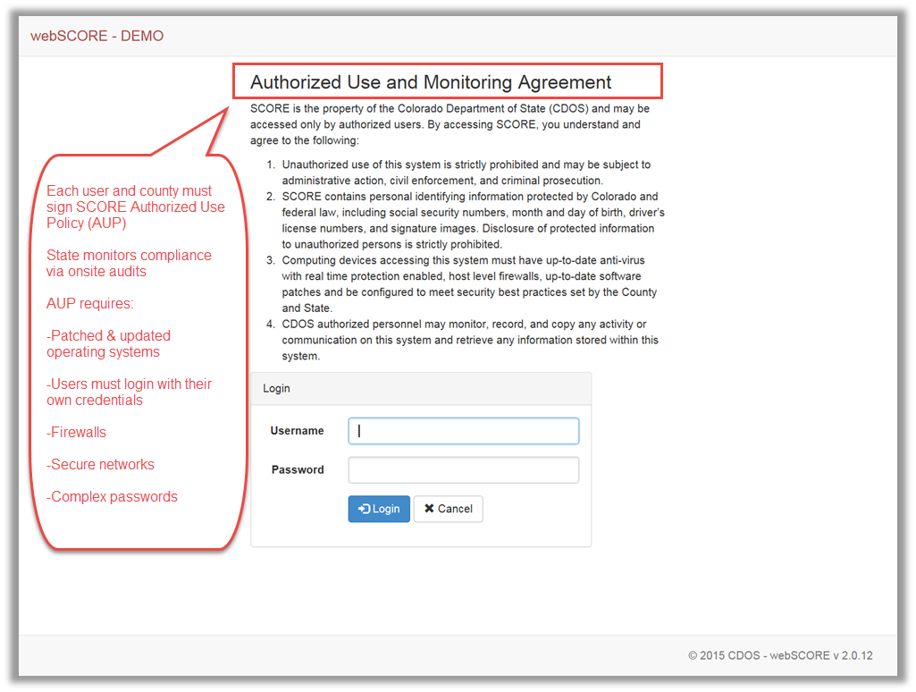

Slide 13
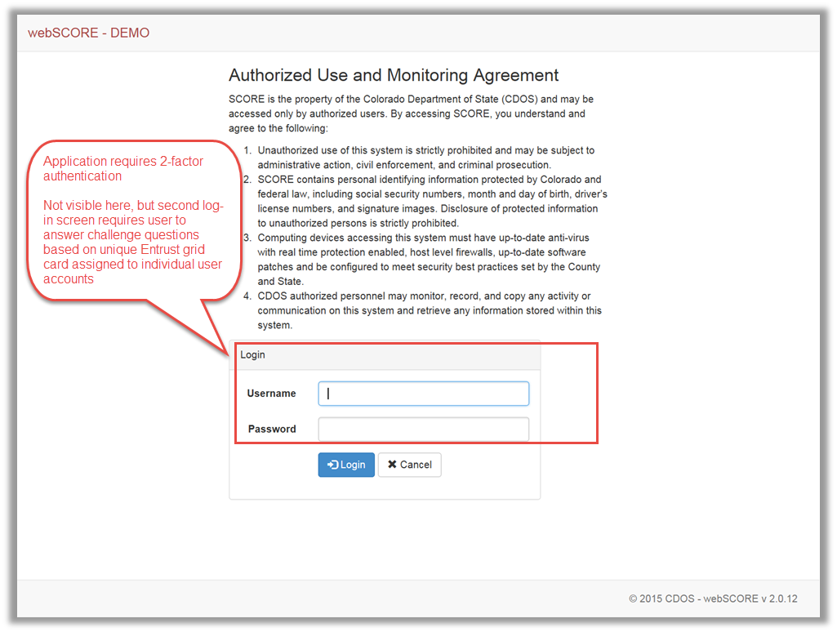

Slide 14
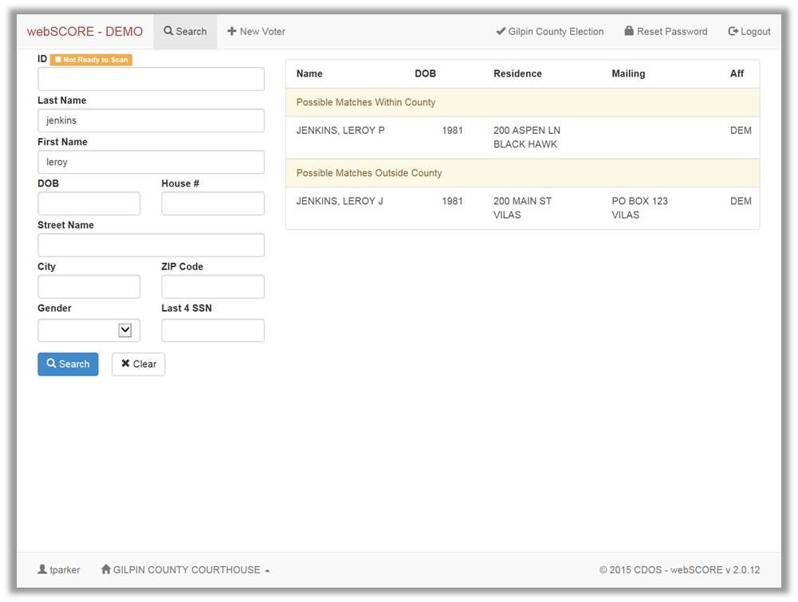

Slide 15
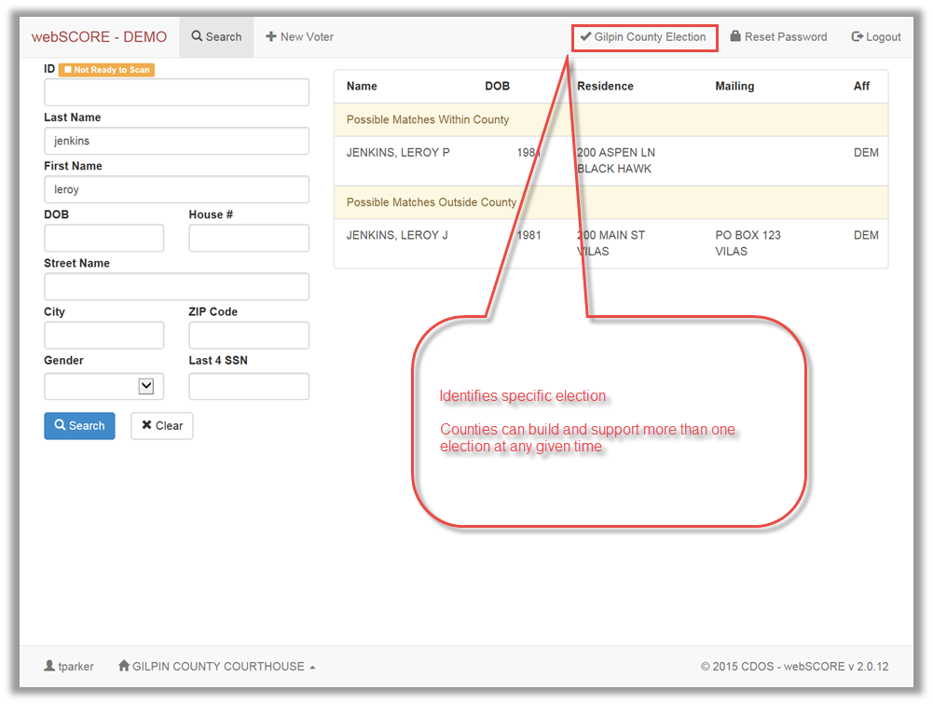

Slide 16
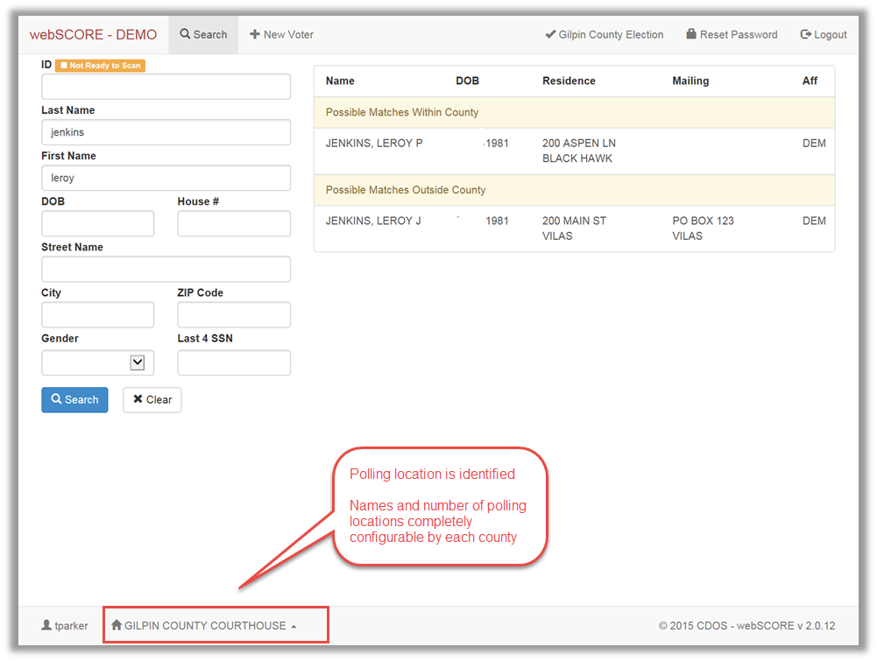

Slide 17
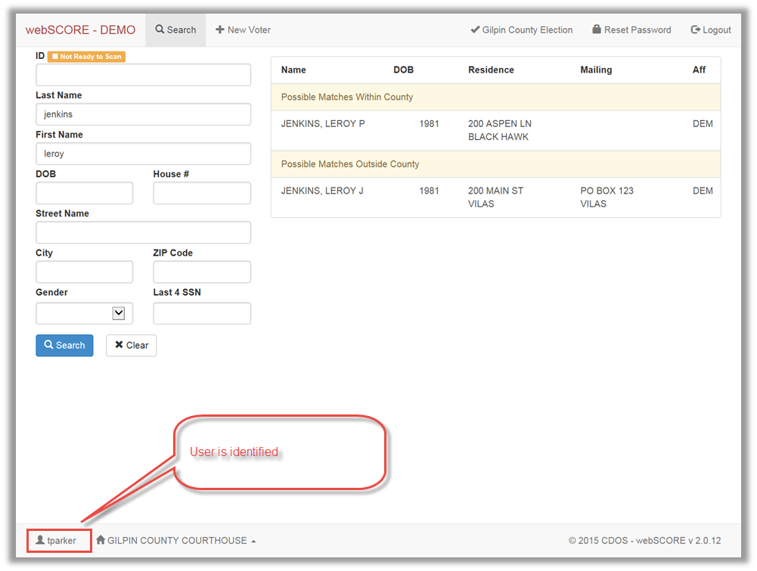

Slide 18
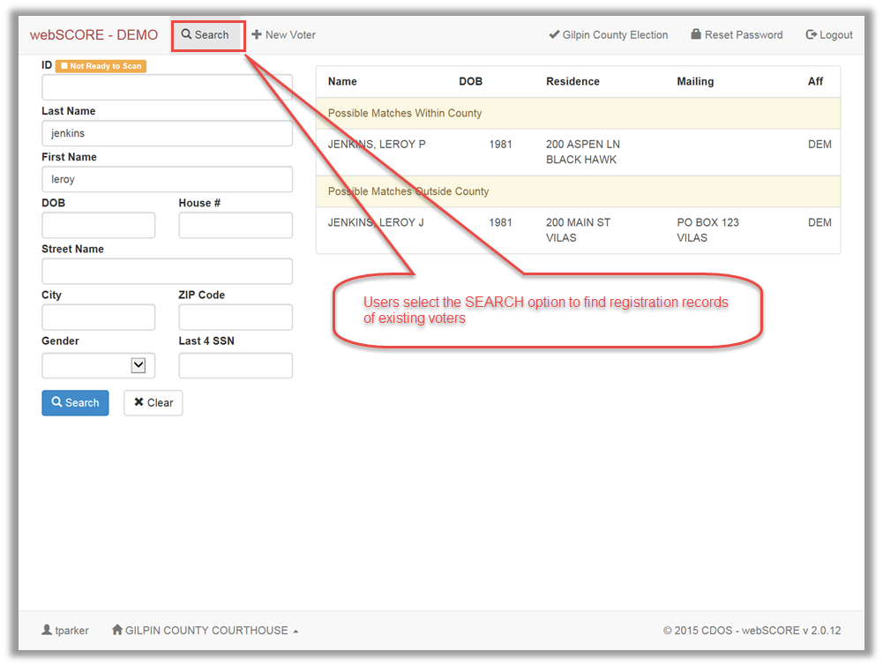

Slide 19
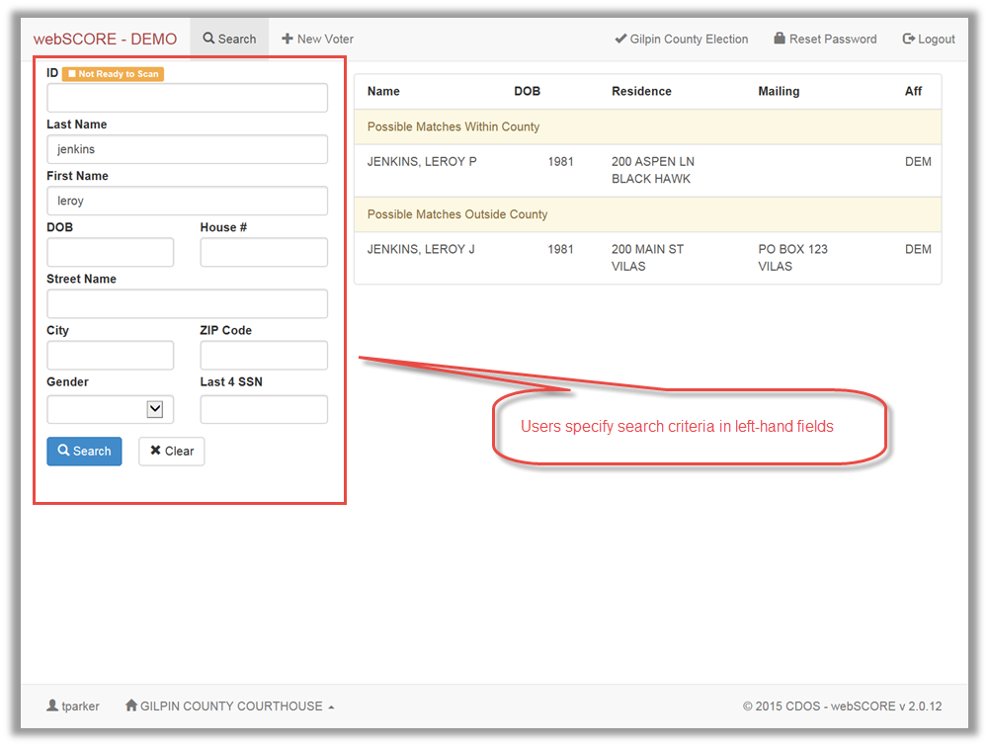

Slide 20
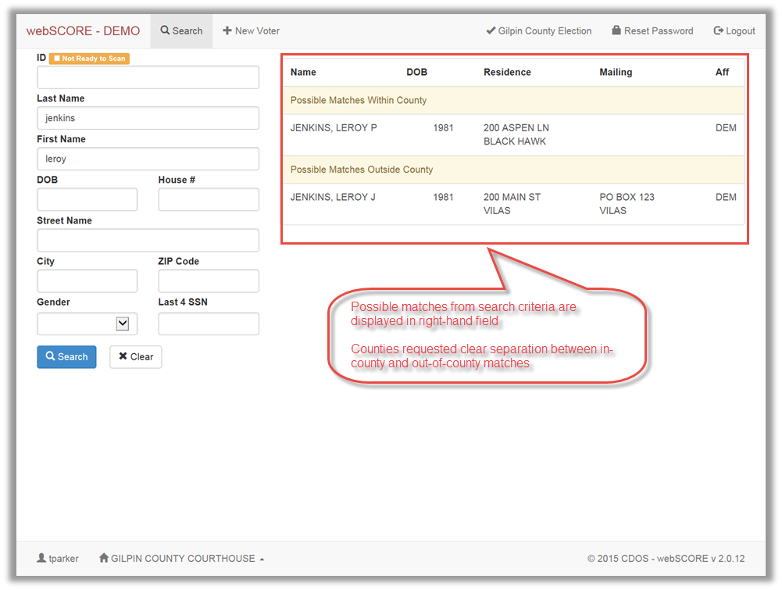

Slide 21
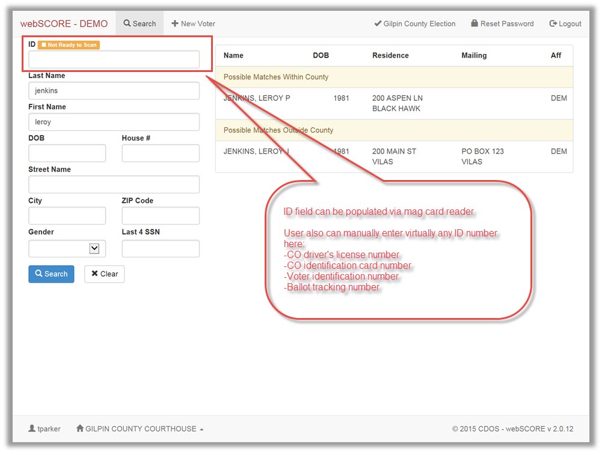

Slide 22
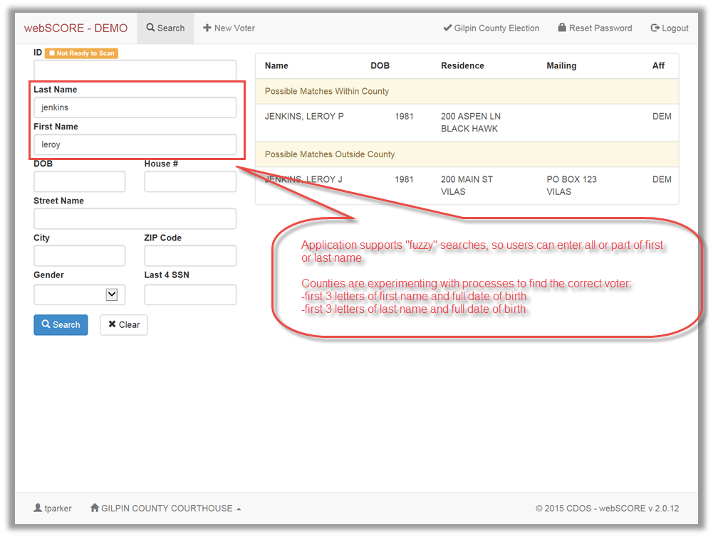

Slide 23
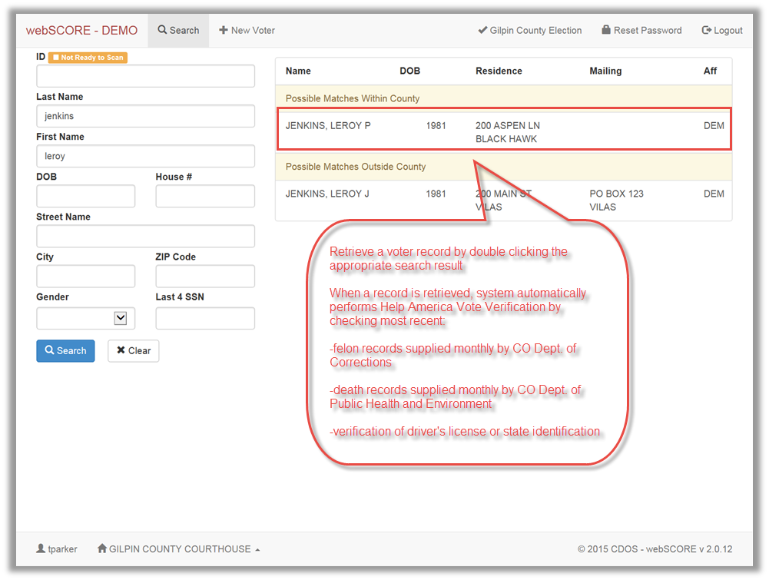

Slide 24
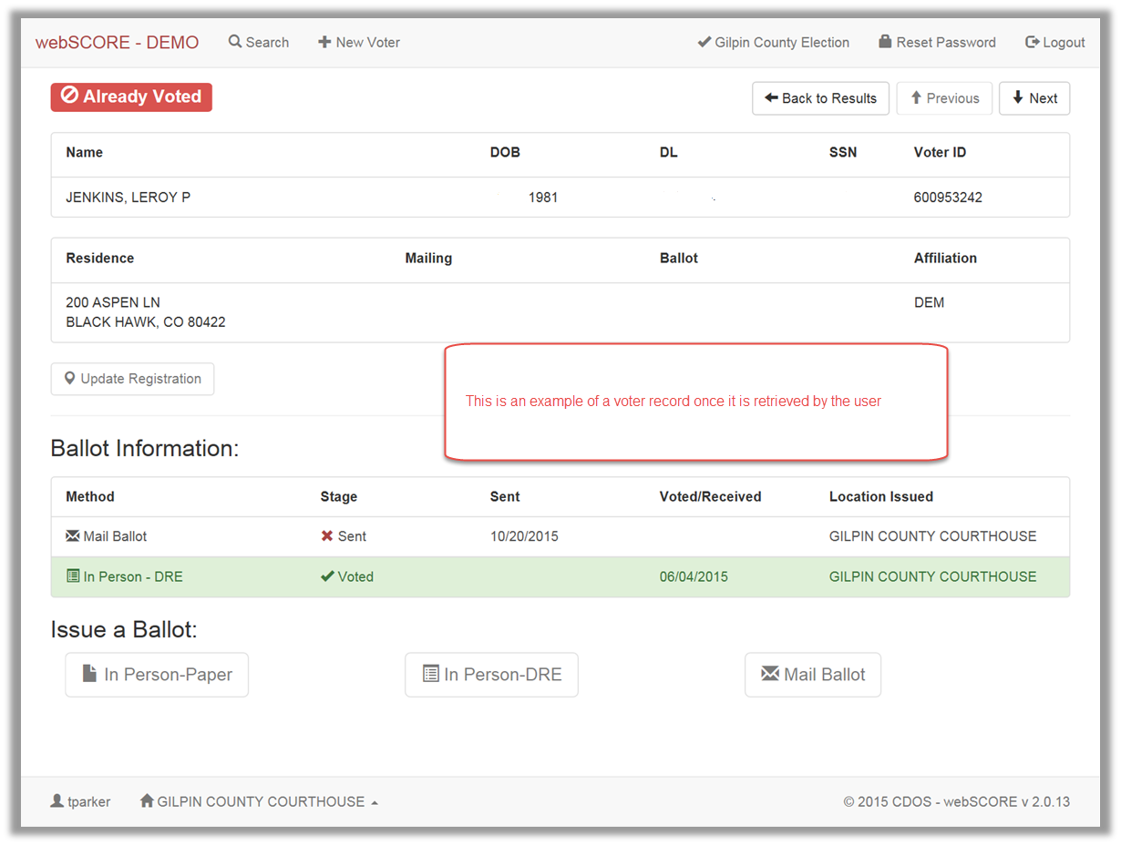

Slide 25
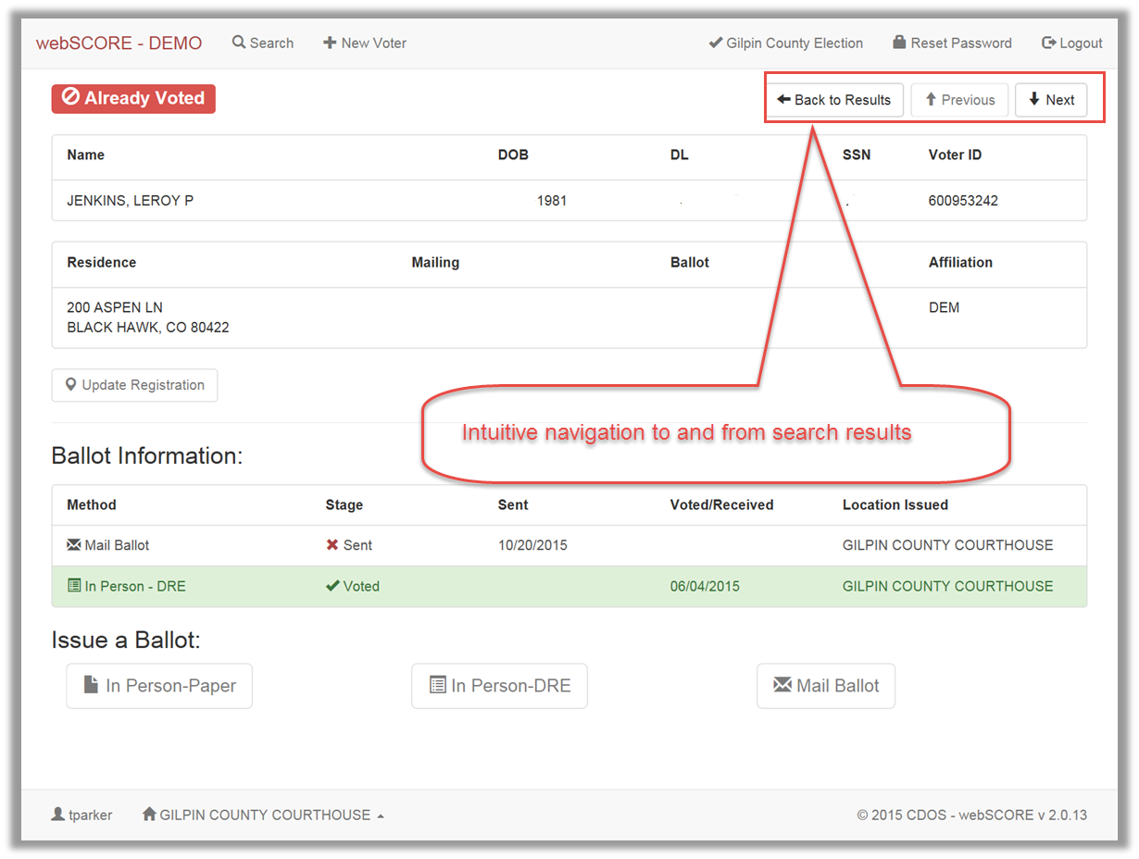

Slide 26
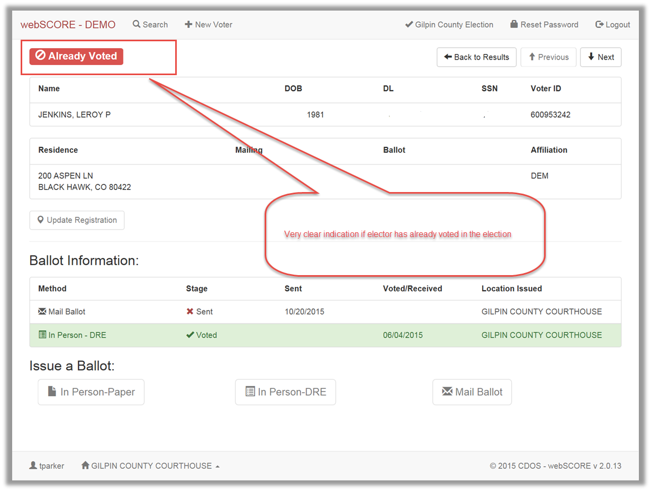

Slide 27
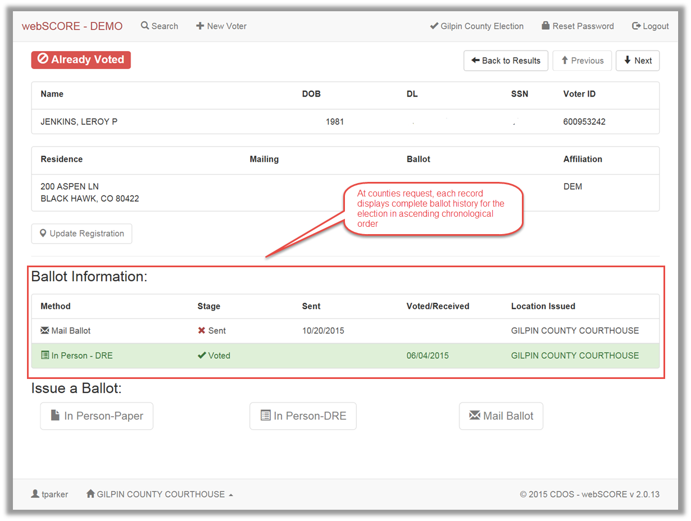

Slide 28
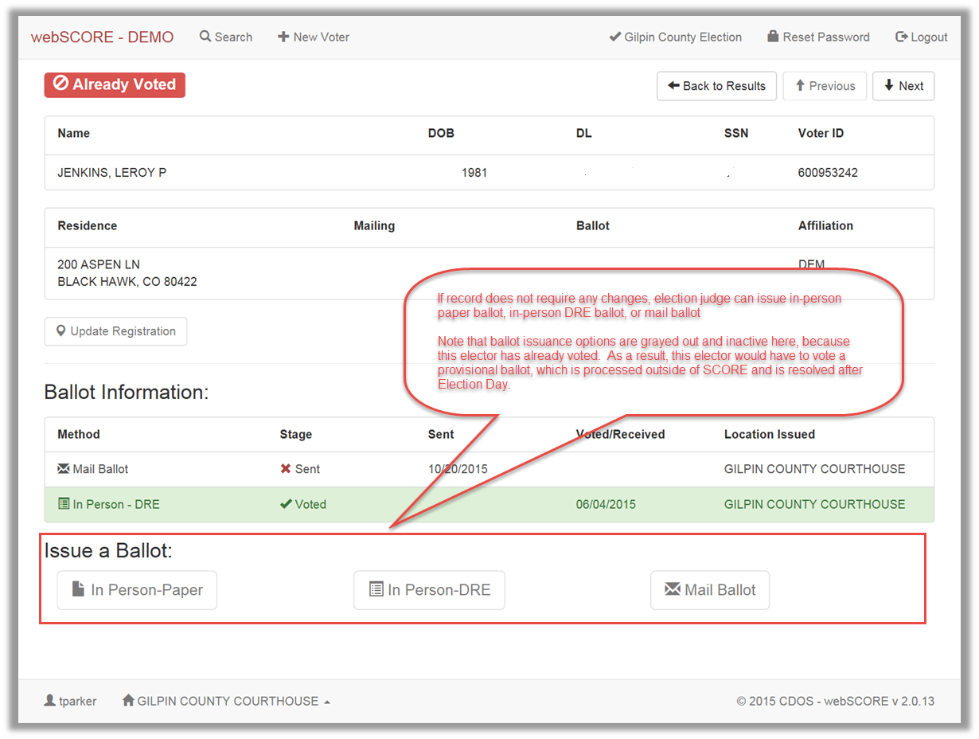

Slide 29
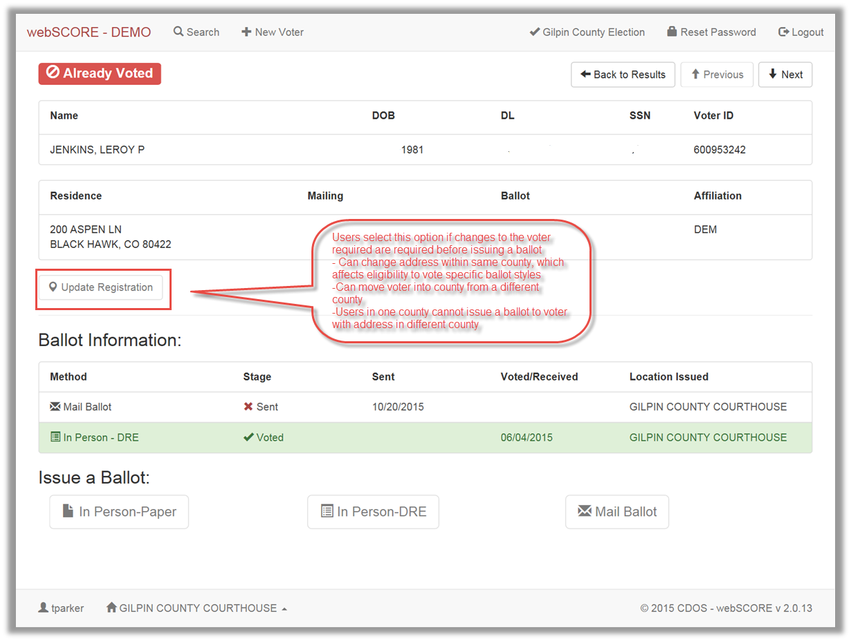

Slide 30
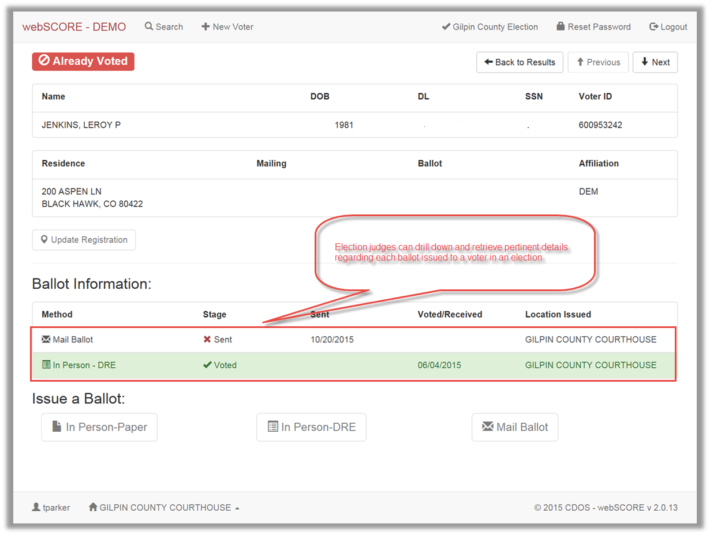

Slide 31
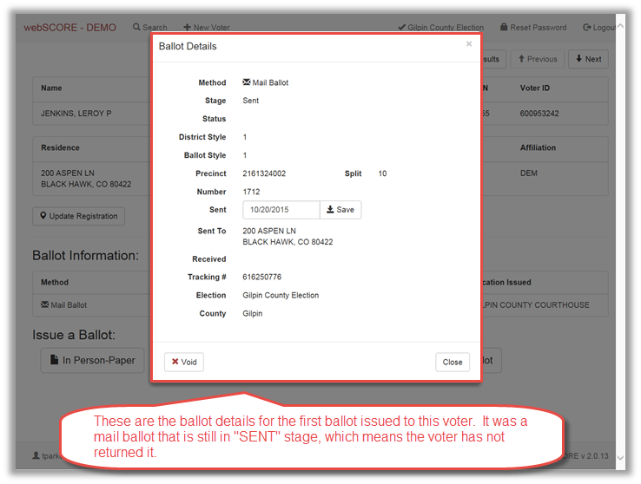

Slide 32
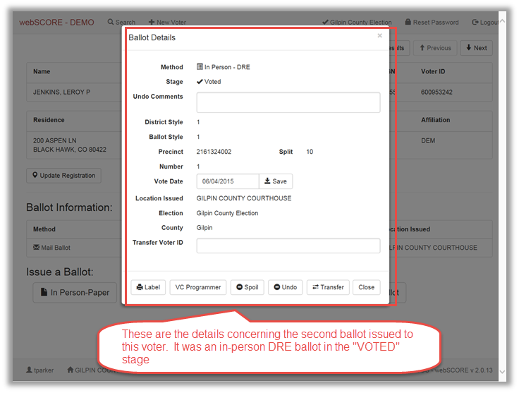

Slide 33
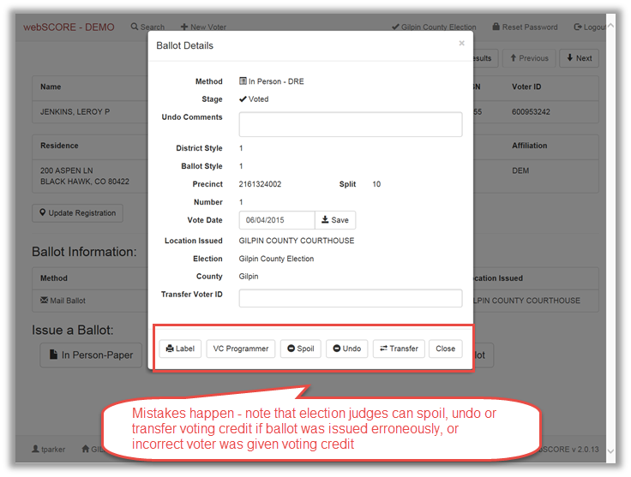

Slide 34
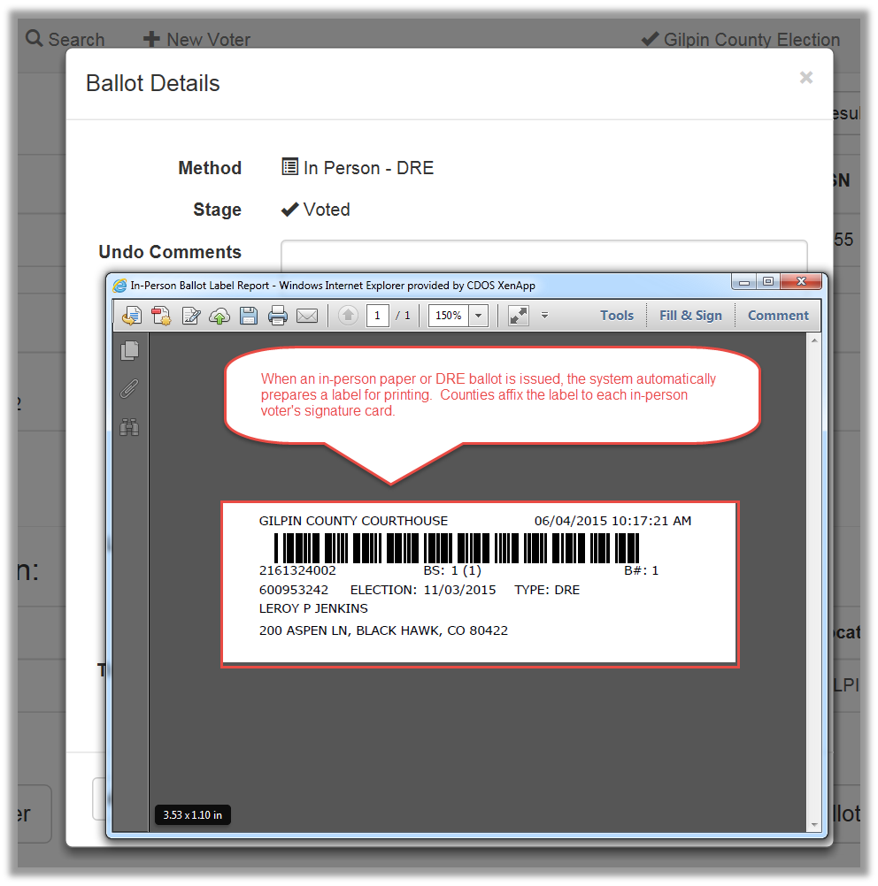

Slide 35
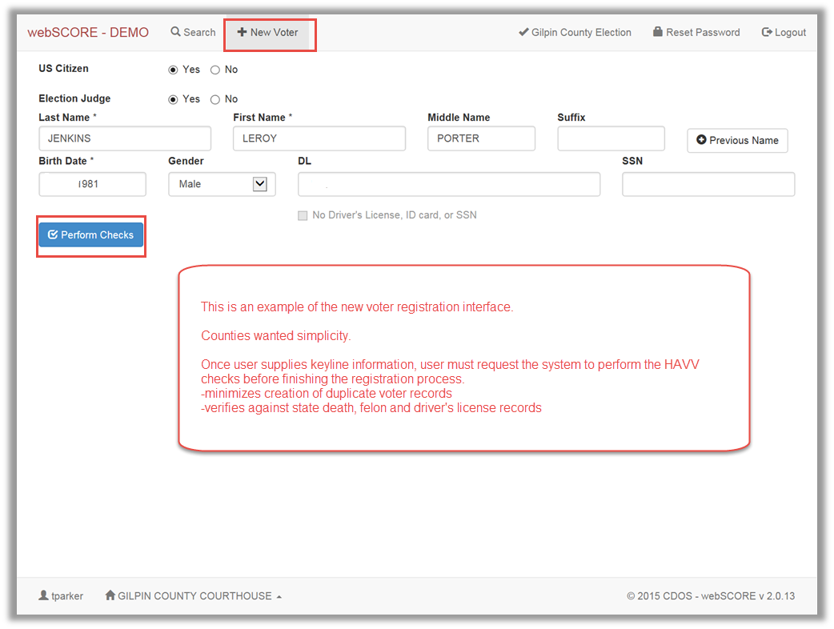

Slide 36
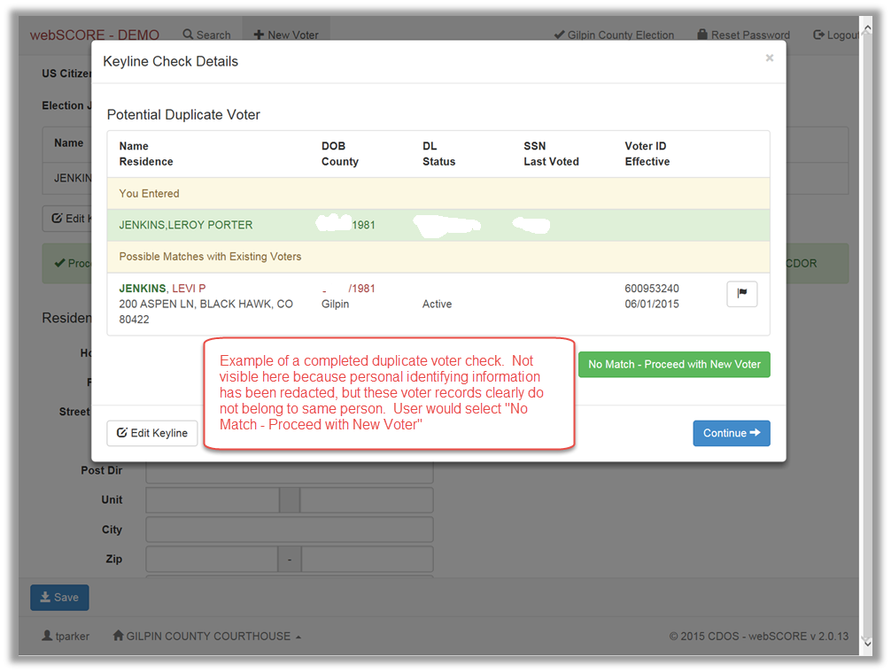

Slide 37
