Slide 1
Public audit signage
8x12”
Can be resized for printing at 12x18” or 24x36” (vertical signage)
2025

Slide 2
Delete this slide when you finalize your design
Guidelines for editing the signage
Replace the seal with your own county or state seal
Be sure to update the design with your own county’s name and relevant dates
Change or switch out terms that your jurisdiction uses (for example, absentee voting instead vote by mail voting)
If your county’s website link does not fit the provided space at the bottom, work with your IT team to create a shortened or vanity URL that is simple and easy to remember.
E.g., vote.state.gov/register or govote.state.gov
You can change the colors to better match your organization’s branding. If you do so, be sure there’s enough color contrast to make it accessible.
If you are having trouble editing design elements of the design (like the red bar on the top), on the PowerPoint menu, go to View > Master > Slide Master to make those changes.
This template uses the Noto Sans font family available through Google Fonts. Noto Sans is a legible font with robust language support.
Export the file as a PDF to get printed professionally.

Slide 3
Overhead signs (directional and informational)

Slide 4
Sign in

Slide 5
Observers and Media

Slide 6
Sealed ballot containers

Slide 7
Ballot Numbering and Sorting

Slide 8
Hand Tally Stations

Slide 9
Completed Ballots & Laptop Totals

Slide 10
Ballot Duplication

Slide 11
Wall signs (informational)

Slide 12
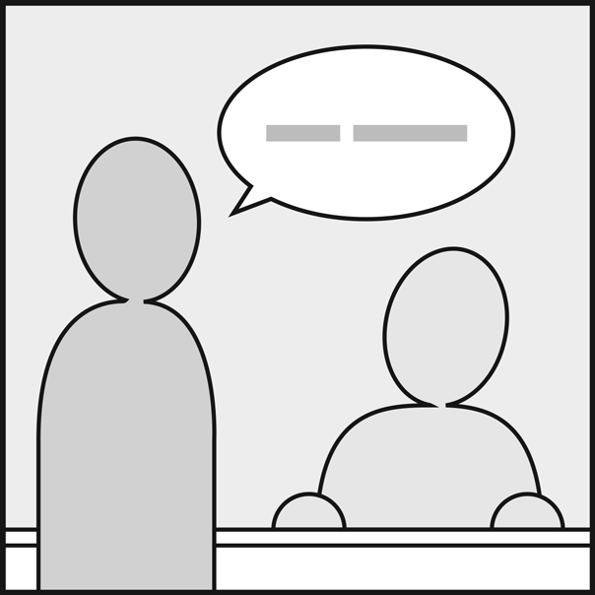
Sign in
Verify your credentials and political party
Complete the oath
Receive access badges and bands
Jurisdiction Name
Seal Logo
Helper Text or Filename – Your Town, USA

Slide 13

Observers and Media area
Name badge and white wristband required
Jurisdiction Name
Seal Logo
Helper Text or Filename – Your Town, USA

Slide 14
“Observer and media area” additional signage in 36x24” size:
Public audit signage 36x24 - DRAFT

Slide 15
Audit work area
Name badge and green wristband required
Jurisdiction Name
Seal Logo
Helper Text or Filename – Your Town, USA

Slide 16
“Audit work area” additional signage in 36x24” size:
Public audit signage 36x24 - DRAFT

Slide 17
Ballot holding and storage
Secure storage with video surveillance
Only election office staff are allowed here
Jurisdiction Name
Seal Logo
Helper Text or Filename – Your Town, USA

