Slide 1

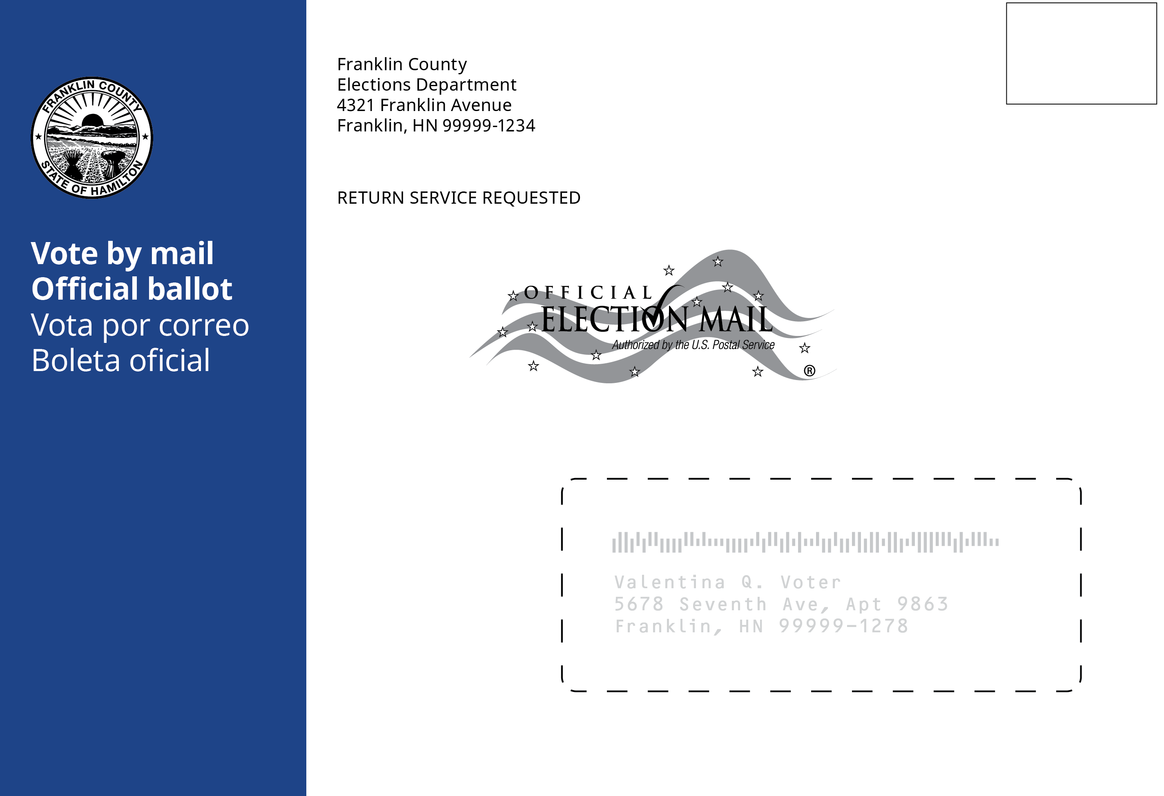
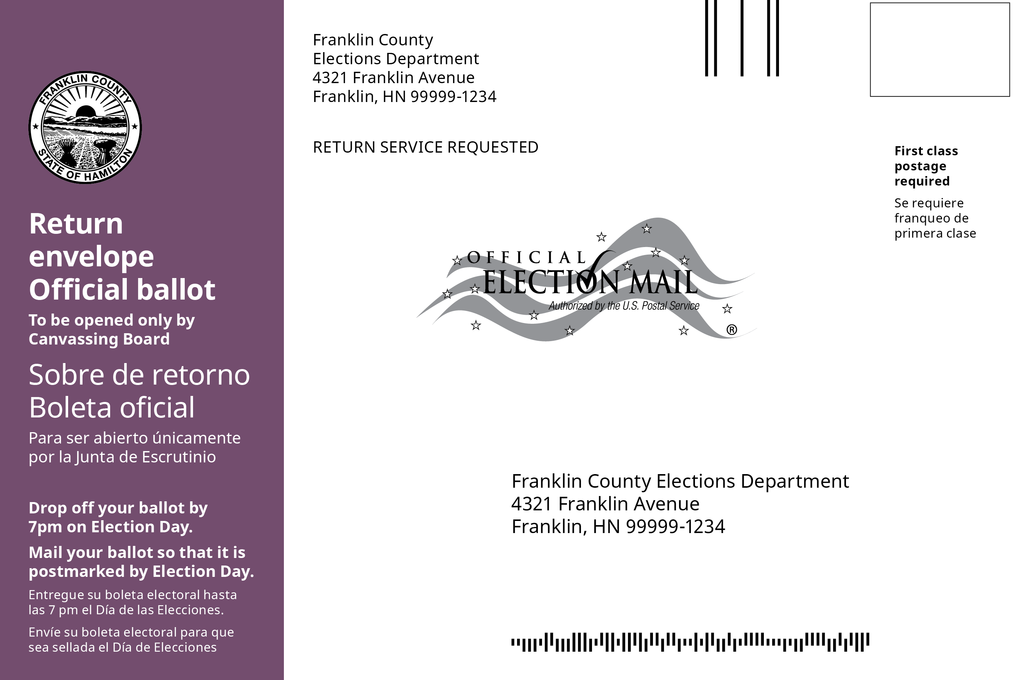
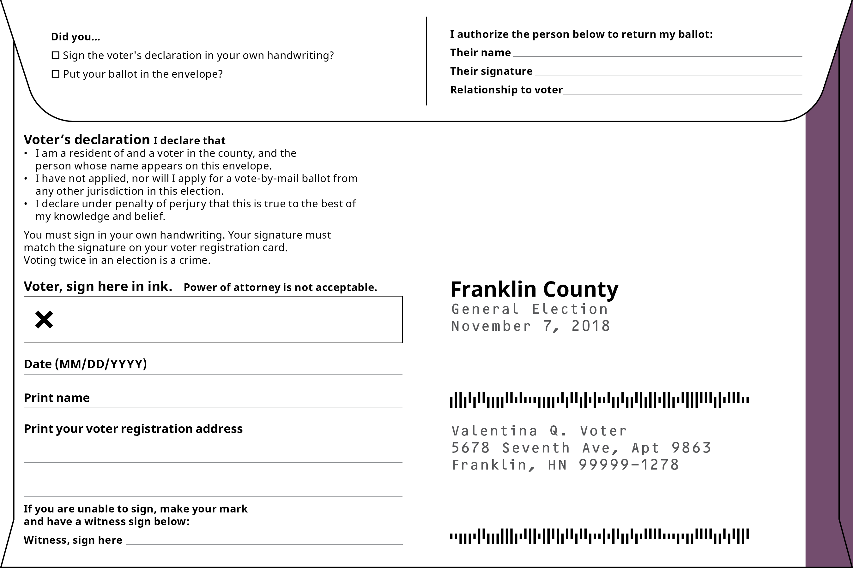
There’s a new look for mail-in ballot envelopes in [Jurisdiction]
Help us get ballots delivered to the voters and back to the elections office – quickly and accurately
Blue envelopes are for delivery to voters
Front of the envelope
Look for the blue stripe
on the left side of the envelope.
The voter’s delivery address is on the front.
The IMB includes an election mail STID
Purple envelopes return ballots to the elections office
Front of the envelope
Look for the purple stripe.
Special elections may use other colors.
The elections office address
and IMB area on the front of the envelope.
Back of the envelope
This side is for the voter’s use only
Do not deliver to the voter’s address
on the back
✘
Together we can make the 2020 elections a success.
Have questions? Contact the Jurisdiction Elections Office at
222-555-1234 or electionmail@jurisdiction.gov.

