Slide 1
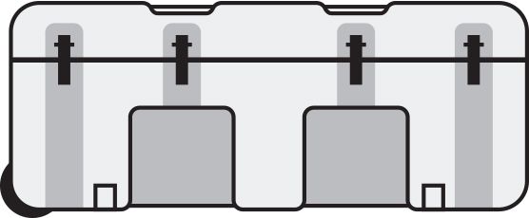
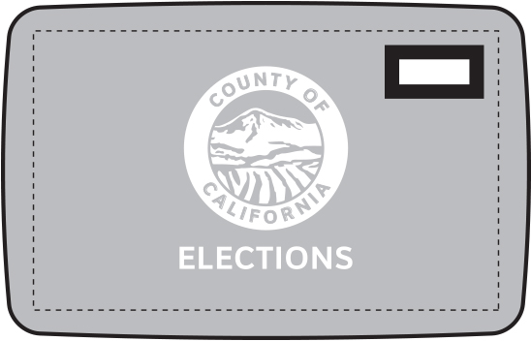

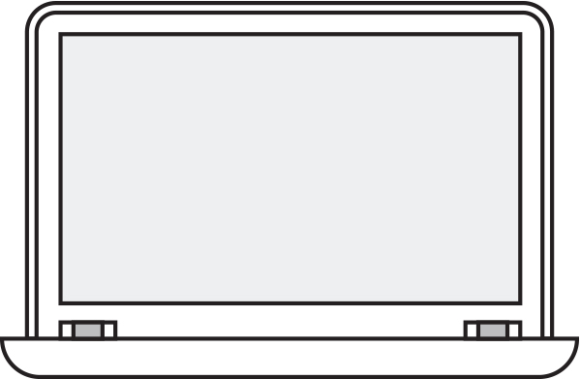
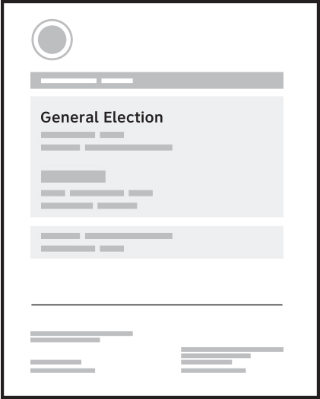
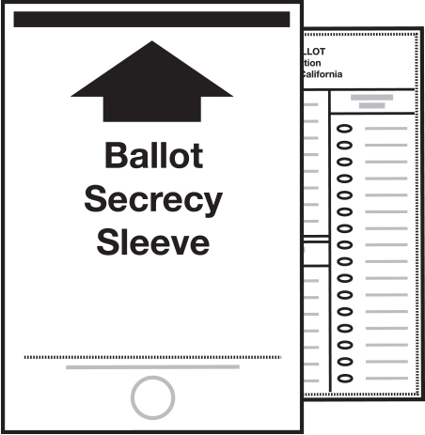
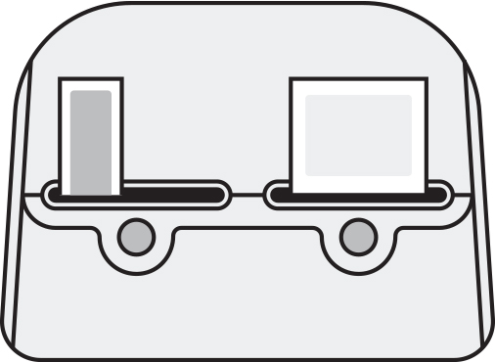

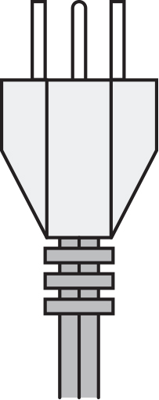
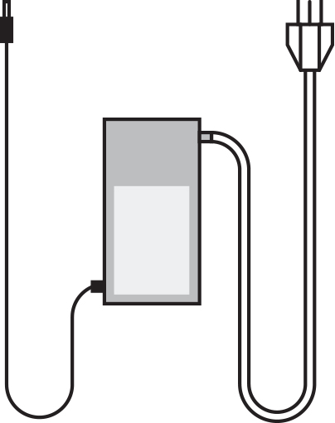
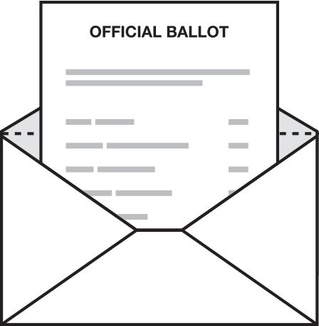
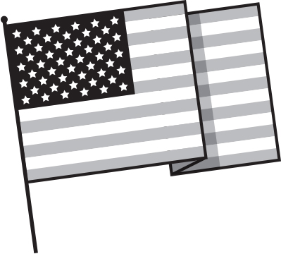
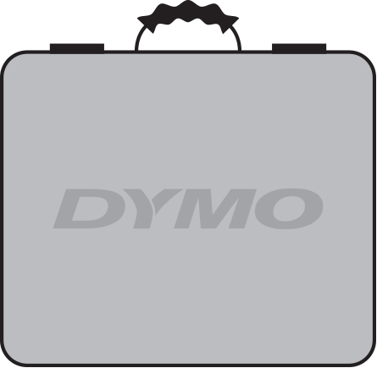
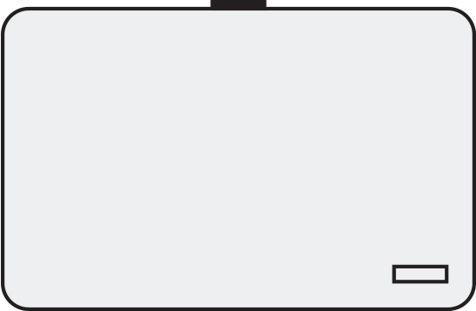
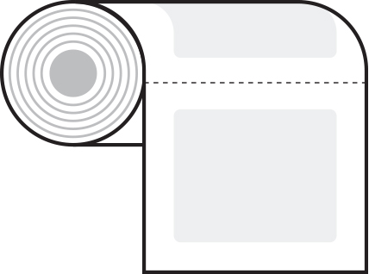

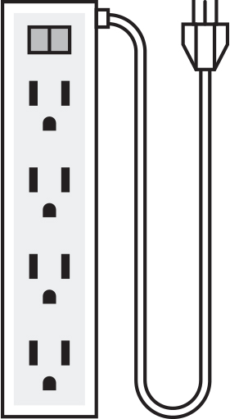
Opening the vote center before the polls open
Find these materials in the supply box
Find these materials in the orange canvas bag
Supply box
Canvas bag
Network cables
Dymo printers
Laptops
Voter guides
Ballot secrecy sleeves
USB cables
Dymo power cables
Laptop chargers
Ballot envelopes
American flag
Surge protectors
Dymo printer cases
Laptop cases
Dymo labels
Pens

Slide 2
How to set up the check-in table
Pens
Dymo labels
Ballot envelopes
Voter guides
American flag
Ballot secrecy sleeves
Laptop chargers
Laptop
Dymo printer
Dymo power cables
Surge protector
USB cable

Slide 3

Closing the vote center after the election
Pack these materials in the supply box
Pack these materials into the orange canvas bag
Pack these materials into a cardboard box
Network cables
Dymo printers
Laptops
Voter guides
Ballot secrecy sleeves
USB cables
Dymo power cables
Laptop chargers
Ballot envelopes
American flag
Surge protectors
Dymo printer cases
Laptop cases
Dymo labels
Pens
Supply box
Canvas bag
Cardboard box

