Slide 1

Implementing the Best Practices for California Voter Guides
Updating your Voter Information Packet for 2016
Nancy Frishberg
Whitney Quesenbery
Center for Civic Design
March 22, 2016

Slide 2
About this project
Developed materials based on the recommendations from our 2014 Best Practices Manual
Collaborated with 3 California counties to review and revise their voter information pamphlets and other voter information
Got feedback from voters directly
Sharing with all California election offices to promote best practices in the 2016 election and beyond
http://civicdesign.org/projects/how-voters-get-information/
Notes:
http://civicdesign.org/projects/how-voters-get-information/

Slide 3
Reviewing the Best Practices Webinars
http://civicd.link/BPRwebinars

Slide 4
Research-based recommendations
Civic literacy is a huge challenge
Layout and visual presentation are important for comprehension
Plain language can’t be overemphasized
People didn’t know common election words
Voter Bill of Rights is valuable, but hard to read
Use the checklist
Notes:
https://cavotes.org/announcement/2015/apr/sign-our-voter-guide-best-practices-webinars
Slides: https://cavotes.org/sites/default/files/jobs/Webinar1-Overview-2015-0427.pdf

Slide 5
Layout and navigation give readers a roadmap and guidance on the way
Use layout to convey content
Help readers find their way
Show readers where they are
Use design to guide the voter
Include a practice ballot
Make information visual
Use accurate instructional illustrations
Make text big enough
Use upper- and lowercase (not all caps)
Avoid centered type
Use one sans-serif font
Notes:
https://cavotes.org/announcement/2015/apr/sign-our-voter-guide-best-practices-webinars
Slides: https://cavotes.org/sites/default/files/jobs/Webinar2-Visual-Presentation-2015-0427.pdf

Slide 6
Organizing information helps all
Provide a table of contents with page numbers
Give information about the logistics of voting
Connect the County guide and State guide
Organize information by task, one topic per page
Use page layout to make differences stand out
Help voters find their way, with headings and illustrations
Maximize the value of the front cover (10 sec glance)
Organize information into bite-snack-meal chunks
Include overview and details
Make it easy to compare candidates
Voters prefer structured information
….and some wanted as much information as possible
Notes:
https://cavotes.org/announcement/2015/apr/sign-our-voter-guide-best-practices-webinars
Slides: https://cavotes.org/sites/default/files/jobs/Webinar3-Civic%20Literacy-2015-0423.pdf

Slide 7
Plain language improves understanding for all
  Write in short sentences, short paragraphs
  Use everyday words, not election terminology
  Write in active voice, directly to readers
  Keep message positive
  Separate paragraphs with space
  Use large enough type (12 pt or above)
  Use a recommended san-serif font
  Write headings as questions or active instructions
Notes:
https://cavotes.org/announcement/2015/apr/sign-our-voter-guide-best-practices-webinars
Slides:
https://cavotes.org/sites/default/files/jobs/Webinar4-Plain%20Language-2015-0423.pdf

Slide 8
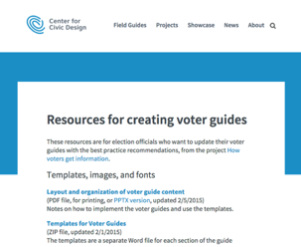
Resources for creating voter guides
Design guide: notes on layout and organization of content
Templates for voter guide pages (Word)
Illustrations and icons in three formats for print, web, posters
Election materials color palette. A variety of coordinated colors, meeting accessibility contrast guidelines
Clearview ADA font and how to get the discount for election offices
http://civicd.link/vgres1
Notes:
D

Slide 9
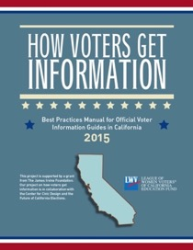
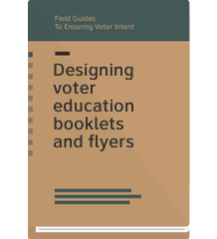
Resources
How voters get information:
Best practices manual for official voter information guides in California
Available from
https://cavotes.org/download-best-practices-manual
Webinars: http://civicd.link/BPRwebinars
Field Guides to Ensuring Voter Intent
Design guidelines for election officials, based on solid research and best practices
Available from
http://civicdesign.org/fieldguides/
Notes:
Download manual at https://cavotes.org/announcement/2015/feb/best-practices-manual-official-voter-information-guides-released

Slide 10
Materials & metaphors

Slide 11
What materials are we discussing today?
Key resources for this training
Layout and organization of voter guide content (PDF and PPTX)
Templates for voter guide pages (zipped files)
  Cover
  Ways to vote
  Ballot-Candidates
  Measures
  Practice Ballot
  Illustrations and icons
  Clearview ADA font
Election offices can use code clvadaelec for a 20% discount
Additional resources
Sample voter guides
Prototype voter guide for “Franklin County”
Santa Cruz County 2014 packet reworked with the new format
Voter Information Packet,
Santa Cruz City School District, November 2015
Before/After examples
All available at http://civicd.link/vgres1
Notes:
http://civicdesign.org/resources-for-creating-voter-guides/

Slide 12
Design constraints
Legal
Present the information as required by law
Fiscal
Aim to not increase the number of pages in the Voter Information guide.
Usable for Voters
Let voters express their intentions easily and quickly.
Usable for Election offices
Use familiar tools (Word, InDesign) to write and format documents
Use free graphics (icons, illustrations) provided by Center for Civic Design
Use free or low cost fonts (such as Clearview ADA)
Notes:
We’re using the term “Voter Information guide” in a non-technical way. We know that many of you refer to the combination of Sample Ballot and guide as “Sample Ballot” or SB/VIP. All of these are correct.
Fonts: Any modern san serif font (including Arial, Helvetica, Univers, Calibri) will work.
We like Clearview ADA because we know it’s effective for people who may have difficulty reading or may be reading under difficult circumstances, as it was designed for readability of highway signage. The font is available at special pricing for election officials.

Slide 13
A metaphor we like
Imagine we’ve prepared a sumptuous banquet for our voters. Do we expect them all to come hungry and ready to eat whatever’s on the menu? Our metaphor gets us to think about writing in plain language from the diner’s point of view.
Bite – Gives the flavor, but it’s not filling.
Snack – Might be enough to satisfy, or tempt someone to go further.
Meal – Follows on a bite or snack. After a meal, who wants more?
Notes:
http://www.inc.com/articles/2001/06/23143.html

Slide 14
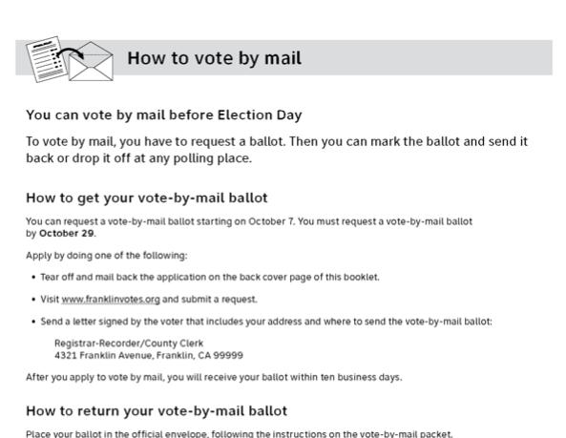
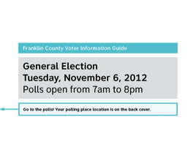
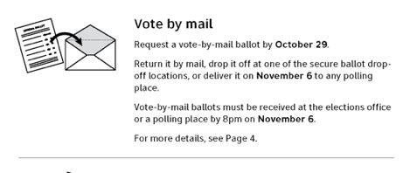
Example of information organized as a bite, snack, and meal
Bite: Shortest possible information
Snack: Summary, with enough information for an experienced voters
Meal: Full details or instructions

Slide 15
Plain language on the menu
The right information: Just what voters need to take the next step.
As short as possible: Edit rigorously.
  1 word, not 2
  Short sentences
  Short paragraphs
Organized: Use headings, typography, and white space to make the structure clear.

Slide 16
Ten Lessons
Evidence-based designs for
Voter Information Guides
Notes:
Dana

Slide 17
Ten Lessons
Covers
TOC
ROV letter
Ways to Vote
  Voter Bill of Rights (SOS)
  How to VBM
  How to vote with paper ballot
  How to vote with electronic ballot
Accessible voting and Languages
Primaries in California
What’s on the Ballot
County + State guides
About the candidates
Paid candidate statements
Measures
Bonus! Ads or filler pages

Slide 18
1. Covers

Slide 19
Cover templates
New formatting creates a consistent look across all 58 counties
One language or bi-lingual
Front cover
County seal
Date/Time of election
Inside front
ROV Letter
Inside back
Update registration
Back cover
Voter name and address,
Address for polling place
Notes:
When we asked “how do you recognize the official ballot and guide?” people pointed to the county seal, the way the address appears…
Even when a voter moves within California, they’ll know it’s an official election guide because it looks like it!

Slide 20
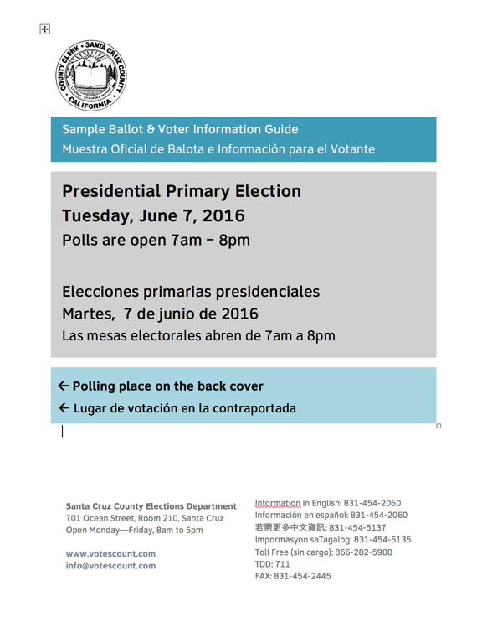
Anatomy of the Front Cover
County seal identifies this document as official, at a glance.
Title of the book
Name and key information about this election
Where’s my polling place?
Contact information for the Elections Office in relevant languages
Notes:
Key information on this page
- County
- Title of book
Election (type of, and date)
Where’s your polling place? (Printer constraints prevent actually showing polling place on front)
Contact info
Plenty of white space – no distractions from the messages.
Left justified text. All one font. Limited number of font sizes.

Slide 21
2. Table of Contents
“What’s in this guide?”
Notes:
Dana

Slide 22
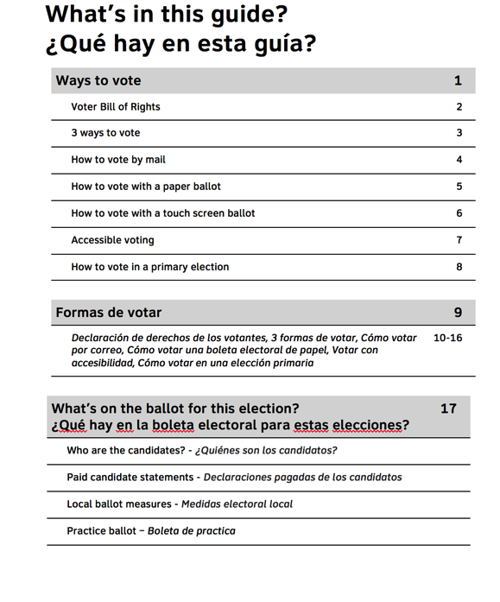
The Table of Contents helps voters find their way
Why?
Helps voters know where they are and where they’re going
What?
Use major sections in the ToC
Include page numbers
Name it something useful (here: What’s in this guide?)
Signal 2 languages at all levels
Layout for What’s in this guide?
Notes:
We noticed during our testing that voters referred back to the Table of Contents while looking at specific pages. This behavior gave us confidence that this page met their unspoken needs.
This page acts as the ToC, but might use the title What’s in this pamphlet? Or What’s in this Voter Information Pamphlet?
In Election Code the state’s booklet is referred to as the Guide, where the Sample Ballot / Voter Information Pamphlet is produced by the county.
This page uses the First page in a “chapter” format, as described in our Layout and organization document.
The illustration uses 2 languages. If you need more than 2 languages, we recommend creating separate guides for each.

Slide 23
3. Registrar of Voters letter

Slide 24
Letter from the ROV
We used an example in all three counties where we tested. Reactions?
  Voters liked seeing it.
  Frequent voters expect it to highlight what’s new.
We recommend:
Highlight what’s new or changed in the voting process.
For example, postmark requirements have changed.
What’s new doesn’t need to fill a full page, but make sure the rest of the page makes organizational sense with the ROV letter.
Notes:
If your ROV is an elected office, you may want to not include a photo or signature to avoid concerns of electioneering. The ROV’s name, office title are fine to accompany the ROV letter. Or do something creative: A photo of the whole staff or something else to personalize and humanize the letter.

Slide 25
4. Ways to vote

Slide 26
Ways to vote
Choose the elements that fit your county’s situation
  Voter Bill of Rights
  How to vote by mail
  Early voting
  How to vote with paper ballot
  How to vote with electronic ballot
  How to vote in a primary
  Others?
Notes:
We’ve listed all the possible elements that might go in this section. You need not include every one. Or you can combine 2 if they fit properly.
Use a single banner for the page, then headings to separate different topics.

Slide 27
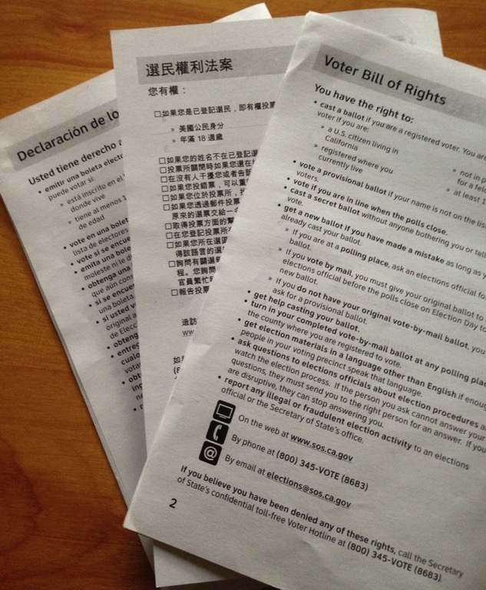
How clear is the Voter Bill of Rights?
Many questions about the meaning of “provisional ballot.”
Surprises (new information)
  Change in franchise following felony
  Replacing a spoiled ballot
  Calling in reports of fraud
  Can vote, if in line when polls close
Comments and concerns
  Requesting a ballot by web, but not vote by web
  Expressing concern about voter ID
The templates include the updated language from Secretary of State’s office. They also have:
Flyer or handout
Polling place poster
Voter Bill of Rights tested in Spanish, Chinese, and English
Notes:
This preliminary work on layout and wording allowed us to rapidly revise the document, culminating in an improved draft for sessions in Sacramento later the same week. Final recommendations sent to the Secretary of State at end of 2015.
Secretary of State’s office has approved the draft version for use in the June 2016 Primary.

Slide 28
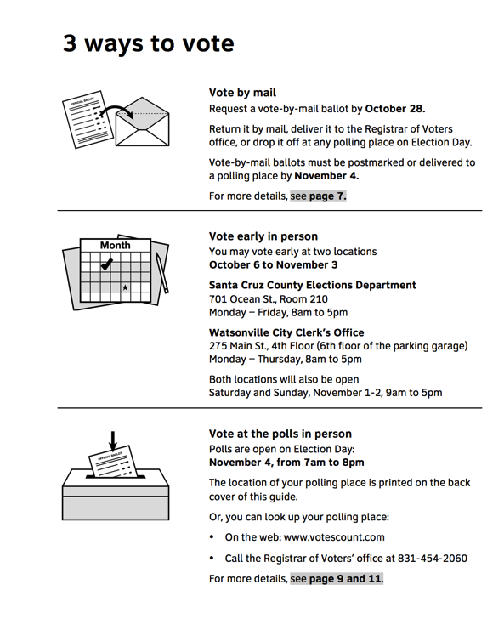
3 (or 2, or 4) ways to vote – a summary of the options for voting
Different top of page signals a new kind of information
Hmm. There are different ways to vote?
Images attract and act as bullets
What do I need to know about my choices?
How do I learn more?
Notes:
This is the snack.
This page follows the First page in a “chapter” format, as described in our Layout and organization document.

Slide 29
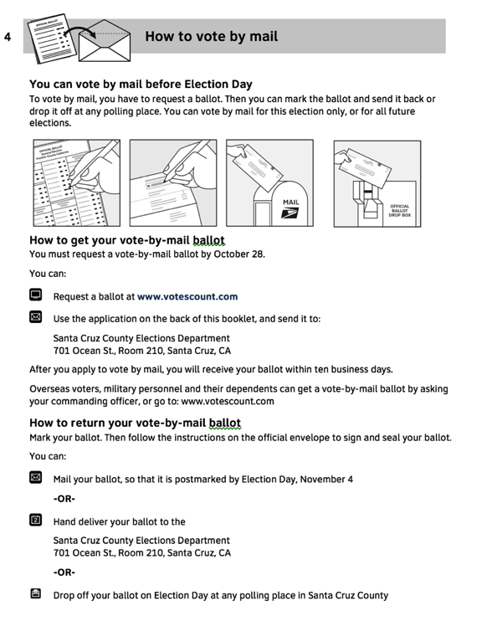
How to vote by mail
New voters appreciate the detailed instructions about
  How to get a VBM ballot
  How to return the VMB ballot
Illustrations available to match your county’s ballot marking style, and return options
Notes:
If you need an illustration that you can’t find in the inventory already, speak up. We want to make sure our illustrations and icons meet your needs. Look in the files on http://civicdesign.org/resources-for-creating-voter-guides/ for illustrations and icons to see the ones we’ve already created.
We’ve updated the illustrations to include ballot styles with bubbles, rectangles, and arrows. Do you have a different style?
We’ve now got full-sized page ballots and narrow style ballots.
What kinds of dropboxes do you use? Will our illustrations work for you?
This page (and others like it filling in details of ways to vote) follows the detail format, as described in our Layout and organization document, starting on page numbered 5.

Slide 30
Ways to vote: Alternative uses
This section can be an "anytime pamphlet."
It can be useful as part of your community outreach for new voters:
Give to voters when they register
Hand out to people about to be eligible (because of age, citizenship status).
Provide official (accurate) information.
Expand on the basic voter rights with accurate information for your county.
Improvements
Make an attractive cover that welcomes new voters, and lists the information included
Possible pages in the booklet
Cover and TOC
California Voter Bill of Rights
3 ways to vote in <this> County
How to vote early
How to vote by mail
How to vote at the polls
How to vote by electronic ballot
Accessible voting
Language assistance
Check your voter registration status

Slide 31
5. Accessibility and languages

Slide 32
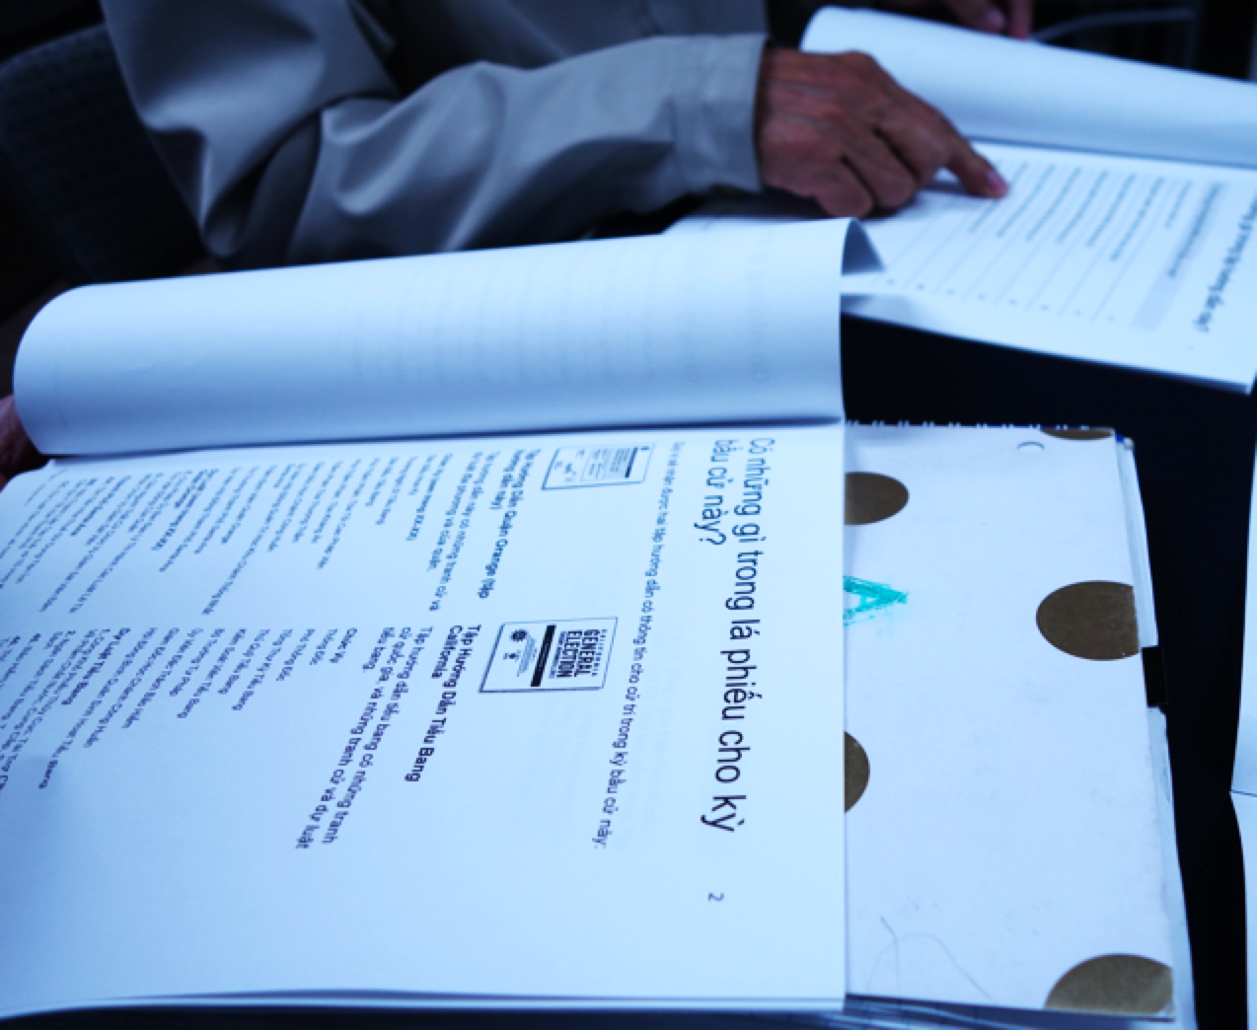
Presenting materials in 2 or more languages
Single and bi-lingual layout samples
Use a consistent layout for all language versions.
Options for layout
Each language in its own section
Facing pages, with English on the right
Most forms will be bilingual
More than 2 languages creates different constraints, and we can work with those also.
Notes:
Layout notes for multiple languages on the cover are shown within the Layout and organization document. Additional notes for other parts of the VIP are also found in the Templates.

Slide 33
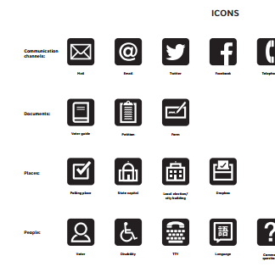
Icons and illustrations
Icons and illustrations that you need are available free of charge
Let us know if there’s another illustration needed to fit your situation, and we’ll create it.
File Format | Uses
.jpg | Printed document
.png | Web and screens
.tif | Large posters and banners
.ai | Adobe Illustrator
Excerpt from icon library
http://electiontools.org/tool/elections-images-library/
Notes:
We provide icons and illustrations in 3 file types which correspond to 3 intended uses.
Files in .jpg format are good for printing, including banners, poster, and ordinary documents.
Files in .png format are sufficient for screen, including webpages.
Files in .tif format are intended for large format poster or banners.

Slide 34
Use color sparingly and consistently
Election materials color palette
(for use in all print and digital applications)
Meets WCAG 2.0 contrast guidelines
Notes:
These contrast ratios make the text accessible for readers with varying vision abilities

Slide 35
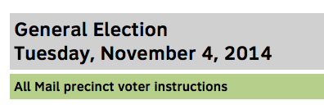
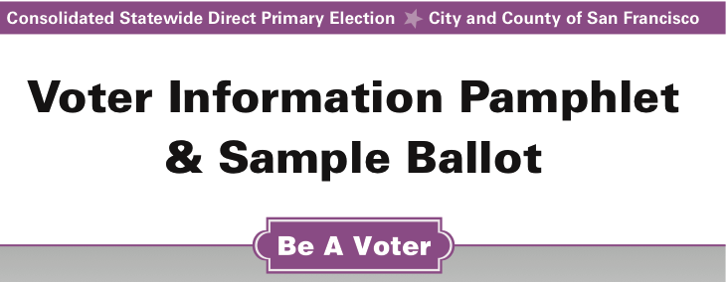
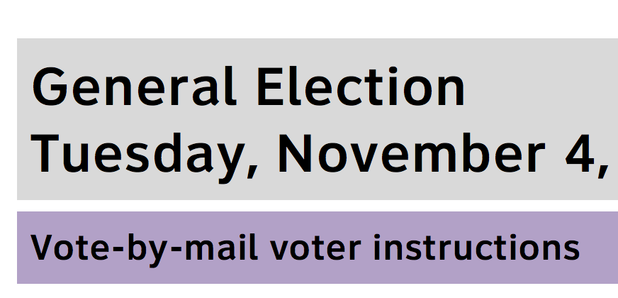
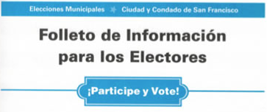
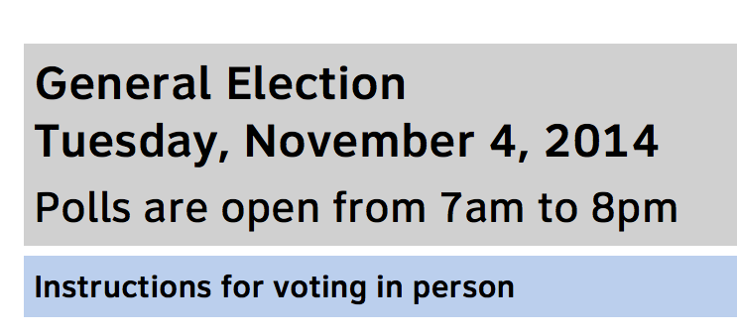

Uses of color for identification
For type of voter or voting option
For language

Slide 36
6. Primaries in California

Slide 37
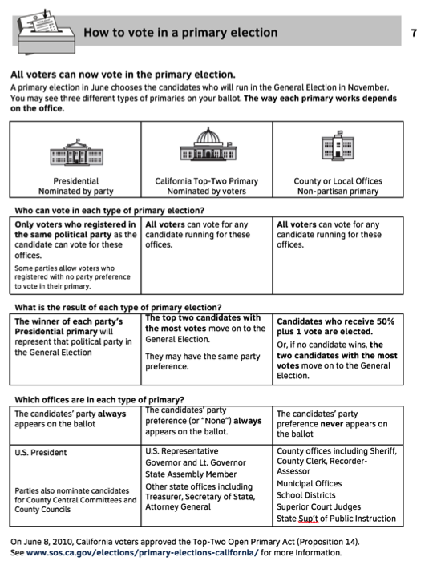
Primaries in California
Many regular voters had difficulty explaining or understanding the top 2 primary system.
The 3 column treatment for the 3 categories of contests worked best with new voters and recently admitted citizens. This version has 4 sections
  Who is eligible?
  Who can vote in each type of primary?
  How do we know who won?
  Which offices are in each type of primary?
How to vote in a primary election
Notes:
Notice the structure combines a table layout, with Q&A.
At a glance it’s clear that there are 3 columns. The voter’s job is to figure out what about those 3 is important for completing this ballot.

Slide 38
7. What’s on the ballot

Slide 39
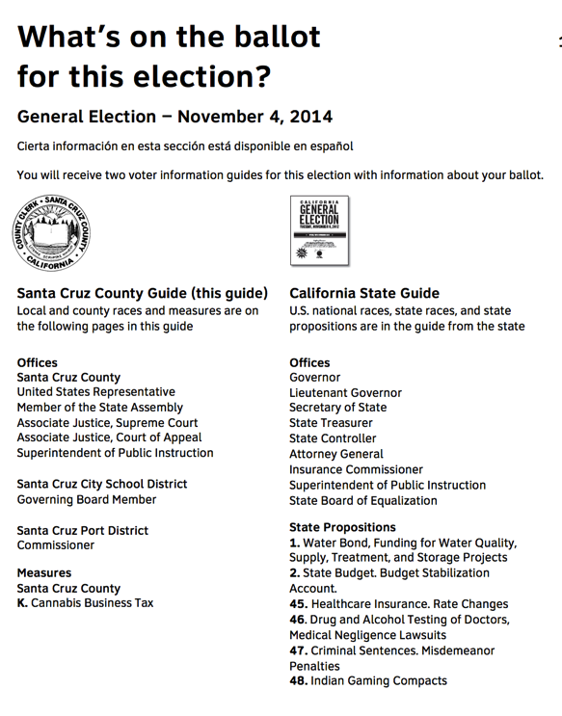
What’s on the ballot
This page is new.
Voters had an “aha!” moment when they recognized the State guide’s cover – there are 2 guides.
It sets expectations about how many pages remain in this guide.
Notes:
This page follows the First page in a “chapter” format, as described in our Layout and organization document. More detailed suggestions on format are included in the page numbered 6 of that document.
At our 2/3/2016 training, several people expressed concern that the title of this page “What’s on the ballot for this election?” might lead to incorrect expectations about the content that follows. We of course invite improvements where needed. The research evidence does not support the concerns, but your intuitions may be correct. Find another simple way to express the idea and then try it out on a small number (5-6) of people. Do the comparison with the title suggested here, in your jurisdiction. Follow the guidance about usability testing found in Field Guide Volume 3, Testing ballots for usability. Let us know what you learn.

Slide 40
8. About the candidates

Slide 41
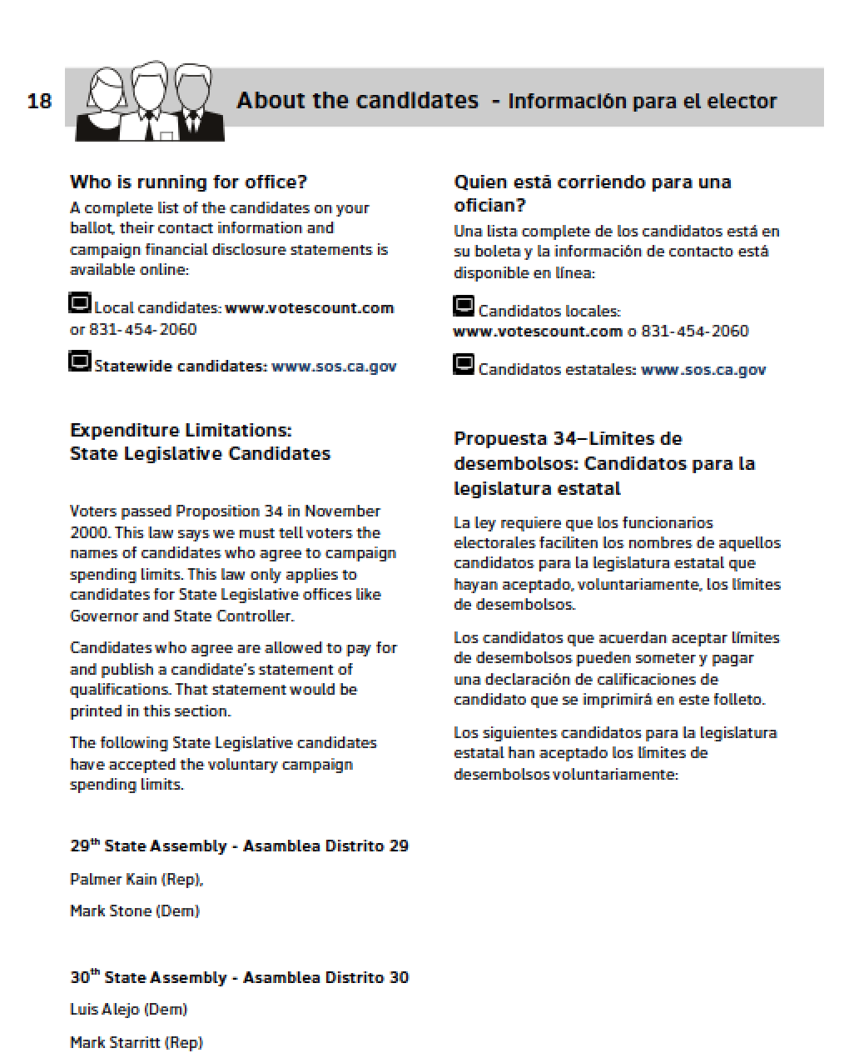
About the candidates
Update content as needed for current election
  About the candidates
  Endorsements
Try new formatting
  For consistency
  For navigational aid
Consider a 2-column treatment for bilingual guide

Slide 42
10. Measures

Slide 43
Measure has up to 5 sorts of content elements
Overview page
Ballot question
Your vote means (yes|no)
Who is For and Against
And...
Arguments for/against measure and rebuttals
Impartial analysis
Fiscal impact statement (when available)
Full text
Notes:
New:
Overview
Ballot Question

Slide 44
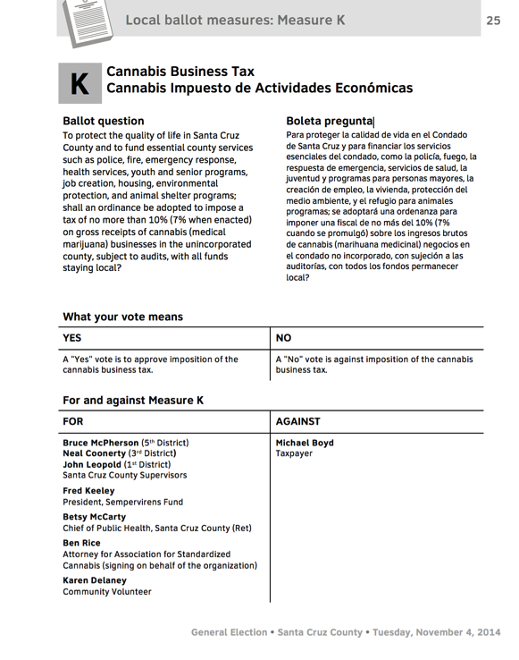
Measures: Overview is new
The overview, inluding the ballot language in the book helped voters get a sense of the measure on a single page.
Layout of a bilingual Overview page
Notes:
We learned
An overview page helps the voter understand the big picture.
What are we voting about?
What does my vote mean?
Who in my community supports or opposes this measure?
This page follows the detailed contents format, as described in our Layout and organization document. There is a specific description of this page starting on the page numbered 7.
At the 2/3/2016 training, we discussed the order of items (which ones are ordered by State Election Code and which are not), and whether the endorsers and opponents belong on this first Overview page or later.

Slide 45
Measures:
Order of elements in packet
1. The ballot title and question orient voters: “What am I deciding?”
Recommended element order
1. Overview: Ballot title and question What your vote means For/Against (list of signatures)
2. Impartial Analysis
3. Financial impact (where appropriate)
4. Arguments / Replies
5. Full text
4. Arguments for and against on one page
Replies to the arguments on the next page
2. & 3. The analysis and financial impact each give a short summary of the issue, and answer questions, such as “Why are we deciding this?”
5. Full text last, because it can be very long
Notes:
Make the text as large as possible, especially on the first page, so it is inviting.
We use language that more voters understand:
- Reply (rather than Rebuttal)
Without an overview page, the order of the information in the prototype does not work well. Voters are not ready to read the arguments, before seeing the ballot language and some introduction to the question.
New voters had trouble understanding that the question itself is on the ballot.
We recommend full text last, so that the voter gets to bite and snack before diving into the whole meal.
The example from Santa Cruz Nov 2014 shows a bilingual treatment for this order with expanded Overview.

Slide 46
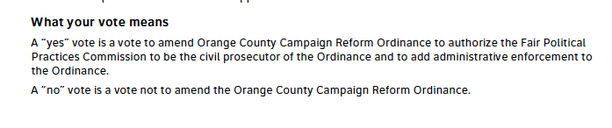
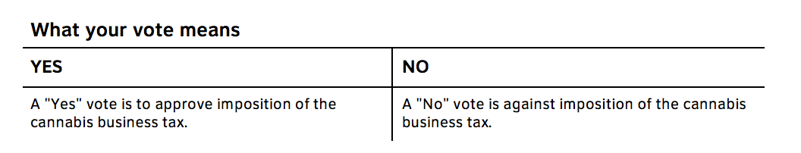
Measures: Impartial analysis
We recommend
Copy the statements from the Impartial analysis spelling out what Yes and No votes mean, and repeat these statements on each measure’s first (or Overview) page.
Example formatted as text paragraphs in the analysis statement
Example formatted as table on the overview page
Notes:
Impartial analysis is recognized as trustworthy by voters.
It’s often difficult to know what your vote means, because of the way a ballot measure is phrased.
Most voters recall being confused by a measure phrased as a negative - for which voting “no” means supporting the substance of the measure.
Note: There was a discussion at New Law (12/2015) about requiring the counsel to write the Yes/No statements for counties where this is not already current practice.
Alternatively, since the statements are usually at the end of the analysis, AND if the analysis fits on the first page, we suggest you appeal to the county counsel to allow this heading What your vote means to be more visible, and thus useful.

Slide 47
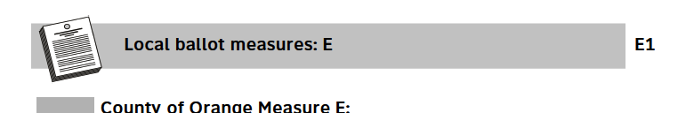
Measures: Page numbers for easier production
Solution: “chapter numbering” for the measures
Solves the production problem.
Makes it easier for the voter to find the measure when flipping through the guide.
Eliminate page number references for individual measures in the TOC
For the Table of Contents, omit the list of measures, and just show the opening page number.
In What’s on this Ballot, omit the the “see pages…” references.
The problem:
If yo create ballot style books by assembling all of the contests and measures on that ballot, the assembly process makes consecutive page numbering difficult.
Notes:
These pages follow the detailed page format, as described in our Layout and organization document. The page numbered 8 gives more guidance on preparing these pages.

Slide 48
Bonus! Ads & Filler

Slide 49
Why filler?
Need content to fill 4 pages in a signature, no blanks
Possible content
  Attract pollworkers
  Remind voters of deadlines to request vote by mail ballots or return vote by mail ballots
  Give more information on accessibility
  Advertise other county agencies and services
What suggestions do we have?
  Match the style to this new look

Slide 50
Research & Code

Slide 51
Recommendations vs. Election Code
Is it... | Or... | Solution
Voter Guide | Voter Information Pamphlet and Sample Ballot | Official title on the cover, but refer to the "Guide" or "Pamphlet" for short
Practice Ballot | Sample Ballot | Use the title "Sample Ballot" but add a sentence in the margin that suggests how to use it
Reply to the Argument... | Rebuttal to the Argument... | Reply Rebuttal to the Argument...
Yes/No explainations on first page | Only in the context of the Impartial Analysis | Copy the text, but leave it in the analysis text. Ask counsel to write this explanation, if it's not already available.
Use a signature to show you are "real" | Or is that campaigning? | Ethics guidance says that you should not use your signature if you are an elected Clerk/ROV
Follow the law, and add plain language to help voters.
Then, let’s get the Code changed, when we can.

Slide 52
Thanks are due!

Slide 53
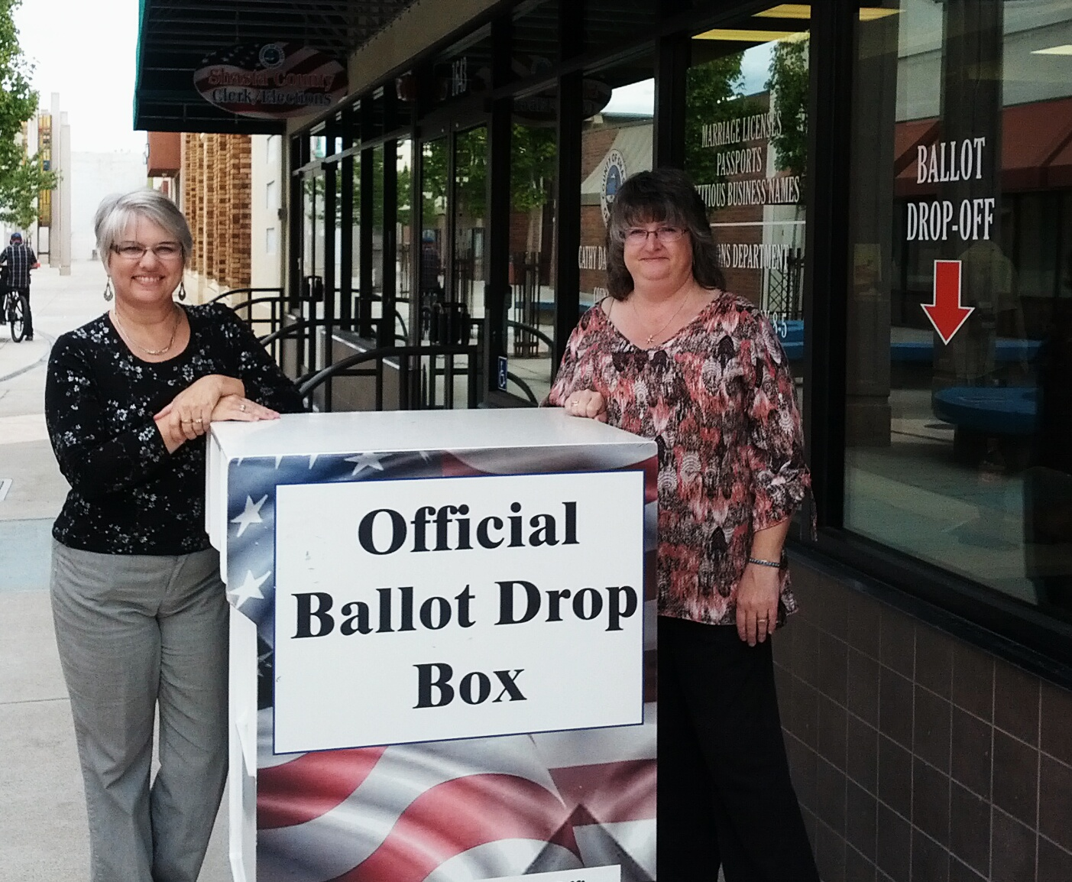
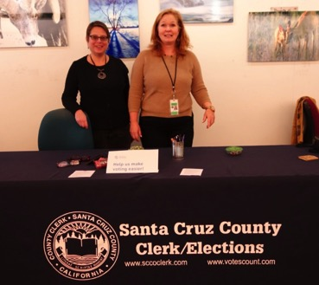
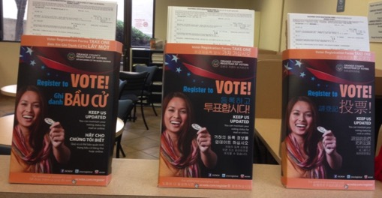
Thanks to
Our partners
Irvine Foundation and the Future of California Elections
League of Women Voters of California Education Fund
Shasta, Santa Cruz and Orange Counties
Our colleagues at Oxide Design
Our training hosts
Glenn, Madera, San Mateo and Orange Counties
And you!
For spending time learning about how to improve your Voter Guide.

Slide 54
Get in touch!
Nancy Frishberg nancyf@civicdesign.org
Whitney Quesenbery whitneyq@civicdesign.org civicdesign.org
@civicdesign

