Slide 1
Usability & accessibility of next generation elections
NIST Roadmap
Notes from the January 9, 2015 workshop
Whitney Quesenbery
Center for Civic Design
Kathryn Summers and graduate students
University of Baltimore
Sharon Laskowski and Shaneé Dawkins
NIST

Slide 2
A preliminary report on the workshop, January 9, 2015
This was the second of two workshops in a process to create a roadmap for developing usability and accessibility guidance, best practices, and standards for next generation voting systems that will help election officials, manufacturers, and other stakeholders to ensure that all voters can vote independently and privately.
The roadmap, when completed, will outline steps needed to produce this guidance for election officials, manufacturers, and other stakeholders. It will identify issues, gaps, new technology, and processes, how to develop guidance, as well as relevant research and best practices that can be used to improve voting systems given next generation technology.
In this second workshop, we:
Worked on possible objectives to include in the roadmap
Identified benefits for voters, design challenges, opportunities for the election process, and risks
Heard a presentation about the FDA human factors process for approving products and discussed its applicability to voting systems.

Slide 3
About the Project

Slide 4
Background
NIST has worked on voting system standards since the Help America Vote Act of 2002, both establishing requirements for certification test labs and creating the Voluntary Voting System Guidelines (VVSG). The VVSG 2005 included the first comprehensive usability and accessibility standards for voting systems.
Elections are changing. There are new technologies, new research, new laws, and new elections procedures since the 2005 Voluntary Voting System Guidelines 1.0 were published. Keeping up with these changes requires a new approach to usability and accessibility guidance for election systems.
Recent years have brought changes to the state of the art and technology for voting systems, as well as public expectations about how voters will participate in elections.

Slide 5
Background (2)
Despite 12 years of work within elections on standards for usability and accessibility, the reality is that there are still many barriers.
Even newer systems show poor accessibility and usability, suggesting lack of knowledge of best practices and existing standards and guidelines. This is true of both voting systems and related technology.
As more jurisdictions have switched to paper ballots, there is even more isolation of the "accessible" voting system.
The accessible systems may go unused through the entire day, further reducing the likelihood that they will be set up and ready to use.
Systems for UOCAVA voters under the MOVE Act allow for online ballot marking. Disability rights groups advocate for making these systems available to voters with disabilities (or all voters). Security experts point out many pitfalls.

Slide 6
What is a roadmap?
A NIST roadmap is an outline for future work.
A roadmap:
Identifies gaps in knowledge to be filled
Identifies issues to be resolved
Looks at technology, processes, standards & guidelines
Recommend approaches to the work
It does not:
Prescribe solutions
Recommend specific guidelines
Rather, it shows how to structure work to accomplish the goals
This roadmap will cover future guidance to ensure the usability and accessibility of election systems.

Slide 7
Possible goals for the roadmap
Increase the level of knowledge for how to design, develop, deploy, and use of usable and accessible elections systems.
Promote consistent levels of usability and accessibility across technology in all parts of the elections process.
Make systems more usable for everyone in the elections process, including voters, poll workers, elections staff, and third-parties like election interest and advocacy groups or technology developers.
Shift from single focus on standards and certification to identifying the appropriate guidance and how to implement the guidance, including:
Guidelines for best practices
Procedural support
Training

Slide 8
Where we are in the process
October: Workshop 1 - blue sky, get lots of ideas on the table, explore priorities and gaps
Workshop 2 – Work in detail on elements to be included in the roadmap
Feb 9-10: Future of Voting Systems - Present draft of roadmap
Feb-March: Public discussion and revisions
April-May: Create final version

Slide 9
Results of the 2nd Workshop

Slide 10
Workshop participants
Paul Aumayr, Maryland Department of Elections
Juan Gilbert, University of Florida
Dan Gillette, Gillette Design
Diane Golden, ATAP
Keith Instone, OVF E2E VIV Project
Ed Israelski, AbbVie
Jonathan Lazar, Towson University
Shari Little, ES&S
Ryan Macias, California Office of Voting Systems Technology Assessment
Greg McGrew, Assistive Technology Partners
Jessica Myers, EAC
Brian Newby, Election Commissioner, Johnson County, Kansas
Jim Tobias, Inclusive Design/Raising the Floor
Emily Rhodes, University of Baltimore
Caitlin Rinn, University of Baltimore
Joel Stevenson, University of Baltimore

Slide 11
Structure of the day
Introductions and goals for the workshop
Recap of work to date
Breakout topics: session 1
Lunch talk on human factors in the FDA project
Breakout topics: sessions 2 and 3
Readouts and discussion

Slide 12
What issues must the roadmap address
We started the day by asking everyone to name one top priority for improving the usability and accessibility of future elections. They said:
Better understanding of voters and their needs
Think broadly about voters and their abilities
Having to relearn voting systems every few years is difficult for people with cognitive disabilities
Make paper ballots fully accessible
Involve more individuals with disabilities as poll workers
Thinking about the voting experience
How should voting be similar to and different from everyday processes
Making voting delightful
Universal design: one system for all voters
Access to elections
How to engage voters
Access to voter education
Voting from anywhere
Personalization and socialization of voting
Guidelines for novel interactions with voting systems
Continued

Slide 13
What issues must the Roadmap address (2)
Possible changes in the guidance, standards, and certification process
Standards must address usability, accessibility, and security together
Standards and the legislative process
Raising the level of usability knowledge and design for voting systems
Labs need better guidance and education concerning usability
Standards that keep up wth changes in technology
Possible changes in how systems are designed and tested
Design and test systems for at-risk voters
Test with the people who matter
Change regulations to support iterative testing
Access to real voting systems for researchers
Implementation and pilots in the real world.

Slide 14
Breakout group topics
There were three breakout group topics:
How can the guidance and certification process be improved for better usability and accessibility?
How can we create guidance for the wide range of technologies in use in elections today?
What voter needs are not being met? How can we ensure equal access to voting options?
The groups rotated through the breakout topics during the first afternoon, working on objectives for the roadmap.
They used voter personas, the voter journey map, their collective experience, and ideas from other domains as input for the discussions.

Slide 15
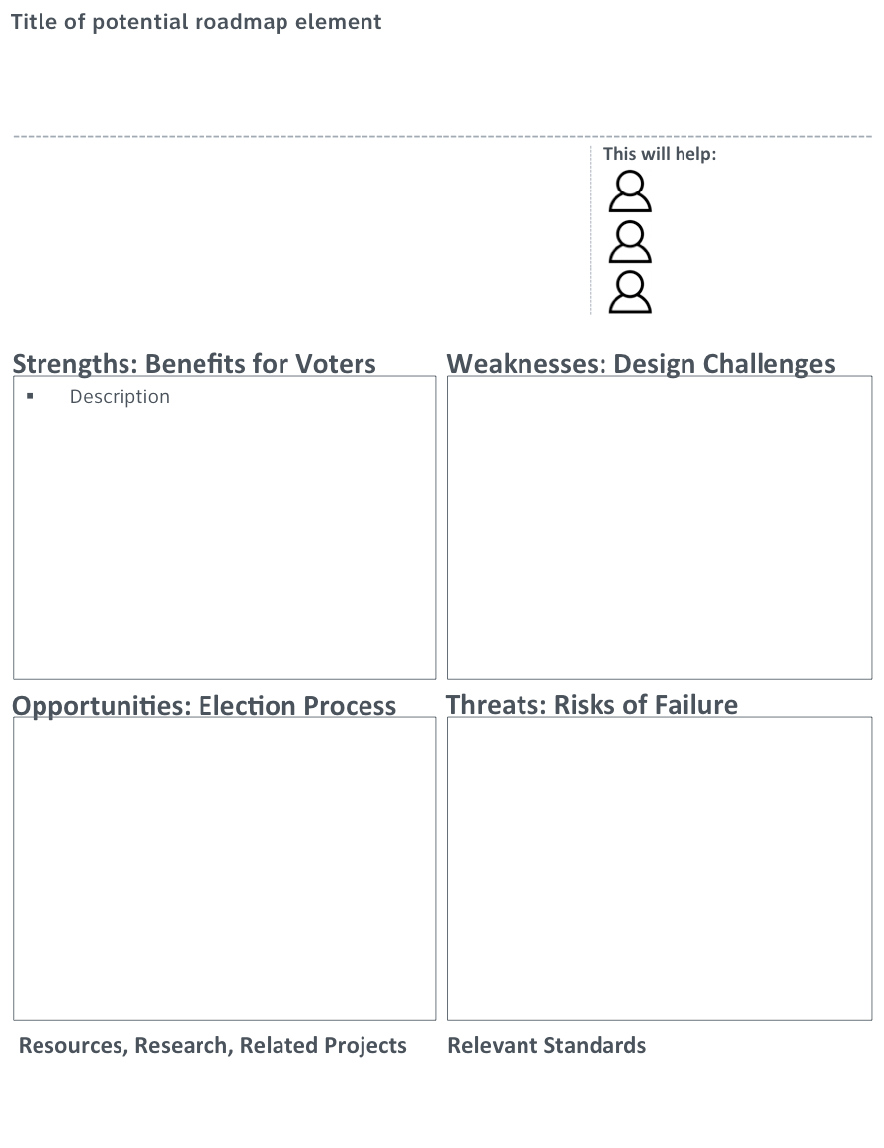
Breakout topic worksheets
The breakout groups proposed and discussed objectives for the roadmap, identifying:
Strengths: Benefits for voters
Weaknesses: Design Challenges
Opportunities: Election Process
Threats: Risks of Failure
Resources, research, related project and relevant standards

Slide 16
One set of requirements: give all voters the best possible accessibility
In the VVSG, Chapter 3 is in two parts, for general usability and accessibility. Merge the entire chapter into one group of requirements, so that all of the requirements apply to all systems, giving all voters the best possible accessibility.
Voters with disabilities who know they need access features
Voters who would benefit from access features, but don't ask for them
Poll workers and election officials
Encourages a more robust universal design approach.
Better accessibility for all voters such as choice of text size & contrast or audio reading of text.
One voting system for all voters – no isolation of the accessible voting system.
Could make systems harder to design well.
Could lead to reduced range of access features.
SAMPLE
Simpler standard. Easier to see all accessibility requirements.
Easier certification with a single set of requirements.
Easier setup at the polling place with one system for all voters, instead of a separate accessible station.
Could make systems more expensive if not designed well.
Voting system designers need education in universal design approaches.
How would this work with component certification? Would all components have to meet all requirements?
Does this make it easier or harder to identify success or failure in meeting HAVA accessibility requirements?
AVT prototypes: EZBallot, Anywhere Ballot, Prime III etc.
Los Angeles VSAP,
Principles of Universal Design
WCAG 2.0 (POUR Principles)
Accessible UX Principles

Slide 17
Concepts developed as roadmap objectives
A theme across all of the discussions was the need to consider all stakeholders in all work.
Voters
Poll workers
Election officials
State election boards and standards
Legislators
Candidates and their campaigns
The concepts developed included 6 broad topic areas. The titles listed on the following pages are often a combination of several concepts introduced at different tables.

Slide 18
Concepts developed as roadmap objectives (1)
Supporting the design process
This group of objectives addressed gaps in how people interact with the current standards and how the quality of election design could improve through better practices.
Design the standards and guidance so they are easier to use
Qualifications of human factors evaluators
Guidance on ussability and accessiblity process
Sharing best practices

Slide 19
Concepts developed as roadmap objectives (2)
Engaging voters
The groups considered the voter experience outside of the actual voting process
Election communications and use of social media
Make voter education (with real voting systems) available to everyone.
Improve voter guides

Slide 20
Concepts developed as roadmap objectives (3)
A broad view of the voter experience
These concepts encourage a broad view of the voter journey and the systems that support it
360° Voter Experience
Human factors and security risk model
Anywhere voting

Slide 21
Concepts developed as roadmap objectives (4)
Supporting evolving technology
The groups looked at how changes in technology has an impact on voting and voting systems
Design guidance for a broad audience, flexible voting systems and more options
Enable the use of personal devices and assistive technology in the voting process
Update voting guidance to address interactions like touch, voice, gesture
Create guidance for election activities outside of the “voting system”

Slide 22
Concepts developed as roadmap objectives (5)
Structure and content of the guidance and standards
This group of objectives looked at what we include in the guidance
Merge usability and accessibility into a universal standard, identifying core requirements
Develop process standards
Simplify standards by focusing on principles rather than detailed requirements
Develop performance metrics

Slide 23
Concepts developed as roadmap objectives (6)
Testing in the design and certification process
This group of objectives looked at how voting systems are evaluaed
Improve ways to test systems, including pilot testing as part of certification
Certification of open, component-based election systems
Educational programs on usability, accessibility, and design for people working on voting systems

Slide 24
Next steps
October: Workshop 1 - blue sky, get lots of ideas on the table, explore priorities and gaps
Workshop 2 – Work in detail on elements to be included in the roadmap
Feb 9-10: Future of Voting Systems - Present draft of roadmap
Feb-March: Public discussion and revisions
April-May: Create final version

Slide 25
Where we are in the process
October: Workshop 1 - blue sky, get lots of ideas on the table, explore priorities and gaps
January: Workshop 2 – Work in detail on elements to be included in the roadmap
Feb 9-10: Future of Voting Systems - Present draft of roadmap with proposed objectives and steps
Feb-March: Public discussion and revisions
April-May: Create final version

