Slide 1
Usability & accessibility of next generation elections
NIST Roadmap
Notes from the October 8-9, 2014 workshop
Whitney Quesenbery and Dana Chisnell
Center for Civic Design
Kathryn Summers and graduate students
University of Baltimore
Sharon Laskowski and Shaneé Dawkins
NIST

Slide 2
A preliminary report on the workshop, Oct. 8-9, 2014
This was the first of two workshops in a process to create a roadmap for developing usability and accessibility guidance, best practices, and standards for next generation voting systems that will help election officials, manufacturers, and other stakeholders to ensure that all voters can vote independently and privately.
The roadmap, when completed, will outline steps needed to produce this guidance for election officials, manufacturers, and other stakeholders. It will identify issues, gaps, new technology, and processes, how to develop guidance, as well as relevant research and best practices that can be used to improve voting systems given next generation technology.
In this first workshop, we:
Explored uses of current and future technology in elections,
Identified gaps in the research, and
Brainstormed new ideas to develop useful guidance.
The goal of these activities was to identify the topics that new guidance must consider and explore the issues that shape current thought on these topics.

Slide 3
Workshop participants
Andrew Baranak, GTRI
David Bjerke, Falls Church, VA
Stephen Blosser, MSU RCPD
Steven Booth, NFB
Mike Byrne Rice University
McDermott Coutts, Unisyn Voting Solutions
Jim Dickson Nat'l Council on Ind. Living
Jeremy Epstein, NSF
Josh Franklin, NIST
Bob Giles NJ Division of Elections
Thomas Hicks, House Admin. Committee
Merle King, Kennesaw Center for Election Systems
Ben Long, NIST
Christy McCormick U.S. DOJ
Alysoun McLaughlin, Montgomery County, MD
Whitney May, ELECTricity
Tammy Patrick, Bipartisan Policy Committee
Sarah Swierenga MSU UARC
EAC
  Megan Dillon
  Monica Evans
  Brian Hancock
  Patrick Leahy
  Alice Miller
  Jessica Myers
  Robin Sargent
  Brian Whitener
University of Baltimore GAs
  Jaime Lee
  Kathryn Locke
  Emily Rhodes
  Caitlin Rinn
  Joel Stevenson

Slide 4
Background
NIST has worked on voting system standards since the Help America Vote Act of 2002, both establishing requirements for certification test labs and creating the Voluntary Voting System Guidelines (VVSG). The VVSG 2005 included the first comprehensive usability and accessibility standards for voting systems.
Elections are changing. There are new technologies, new research, new laws, and new elections procedures since the 2005 Voluntary Voting System Guidelines 1.0 were published. Keeping up with these changes requires a new approach to usability and accessibility guidance for election systems.
Recent years have brought changes to the state of the art and technology for voting systems, as well as public expectations about how voters will participate in elections.

Slide 5
Background (2)
Despite 12 years of work within elections on standards for usability and accessibility, the reality is that there are still many barriers.
Even newer systems show poor accessibility and usability, suggesting lack of knowledge of best practices and existing standards and guidelines. This is true of both voting systems and related technology.
As more jurisdictions have switched to paper ballots, there is even more isolation of the "accessible" voting system.
The accessible systems may go unused through the entire day, further reducing the likelihood that they will be set up and ready to use.
Systems for UOCAVA voters under the MOVE Act allow for online ballot marking. Disability rights groups advocate for making these systems available to voters with disabilities (or all voters). Security experts point out many pitfalls.

Slide 6
What is a roadmap?
A NIST roadmap is an outline for future work.
A roadmap:
Identifies gaps in knowledge to be filled
Identifies issues to be resolved
Looks at technology, processes, standards & guidelines
Recommend approaches to the work
It does not:
Prescribe solutions
Recommend specific guidelines
Rather, it shows how to structure work to accomplish the goals
This roadmap will cover future guidance to ensure the usability and accessibility of election systems.

Slide 7
Possible goals for the roadmap
Increase the level of knowledge for how to design, develop, deploy, and use of usable and accessible elections systems.
Promote consistent levels of usability and accessibility across technology in all parts of the elections process.
Make systems more usable for everyone in the elections process, including voters, poll workers, elections staff, and third-parties like election interest and advocacy groups or technology developers.
Shift from single focus on standards and certification to identifying the appropriate guidance and how to implement the guidance, including:
Guidelines for best practices
Procedural support
Training

Slide 8
About the workshop
The group started from this focus question:
What will the voter experience of elections
be like in the future?
Through a KJ* activity, the group identified 4 priority areas for breakout topics:
  Convenience voting and "Vote Anywhere"
  Accessibility and universal usability
  Trust, security and verification
  Design and evaluation of the user interface
The groups rotated through the breakout topics during the first afternoon.
* See How to KJ: Setting Priorities Quickly http://uxpamagazine.org/how-to-kj/

Slide 9
About the workshop (2)
The discussions of the focus topics identified:
Current and possible future scenarios for usable and accessible elections
Conditions required for these scenarios for future elections
Strategies for supporting voters in navigating across the voter journey
Conditions, challenges, or limits that could constrain these scenarios
This resulted in higher quality notes than just listing issues in each category. However, it can also be hard to capture free-ranging discussion, so the outcomes of these discussions are really input to a more structured discussion in the second workshop.

Slide 10
The voter journey (1)
As the group worked on the 4 priority topics, we used portraits of voters (called 'personas') as a reminder of the range of people who use election systems.
We also looked at the user experience across the entire process of voting, not just marking and casting a ballot. The goal was to be able to think about the context in which the systems are used, not just the equipment.
A simple timeline helped organized the notes by both stages in the voter journey and type of notes.
Preparing to vote
Choosing how to vote
Getting to "the polls"
Marking the ballot
Casting the ballot
Getting the results
Blue sky / future tech ideas
Problems, gaps and opportunities
z
Promising resources
Other Notes

Slide 11
The voter journey (2)
The election process and voter journey is a useful organizing principle, to ensure that the scope is grounded in the voter's process rather than specific technology.
Elections are a service design, requiring coordination of people, procedures, policy, information, and systems.
The voter journey includes learning and making choices as well as the core activities of participation.
There is a wide array of technology systems in use. They include specialized systems, systems used throughout the journey, and general systems used as part of elections
Technology and procedures are used in the context of the voter journey. Guidance for them must take context into account.
Inclusion of a process or technology on the voter journey map does not mean that NIST or the EAC will automatically write standards for it.
The next slide shows a summary of the notes collected on the journey map during the workshop.

Slide 12
The Voter Journey
Preparing
to vote
Choosing how to vote
Checking in/
getting ballot
Marking
the ballot
Casting
the ballot
Verification
& results
Blue Sky Ideas
Elections know me
Use the cloud
Virtual voter representative the "knows" voter configuration
SMS and texting for voting
Vote from home
Vote on a smartphone
Vote on home PC
Build in "negotiation" vs. using personalized config and PII
Preferences for voters match to choices (OK Cupid)
UberVote (car service)
Absentee voters can vote anywhere
Pushing ballot to people the way they want
Online ballot marking tool and backup support
Designed and built by states and voting jurisdictions
A well-designed ballot should be shared via internet or by NIST
Photos of candidates on ballots
Common interactions patterns layout template (so good, you'd be foolish not to use it)
A pilot project with small elections would usability test a ballot design
Ballot designed to work on standard computers
Paper based system then PDF'd and goes to the cloud
Take picture of your ballot and mail or upload it
Audio version of the ballot
One "time zone" for elections
Overall Thoughts
Plain language
Universal ID
Universal WIFI for all devices
Your choice is your choice, regardless of disability
Other Notes
Voters need the ability to "rehearse" to prepare
Identify preferences, not abilities
Personal settings "card"
My details have changed - how to update
Bringing voting (iPad) tech to you
Ballot marking saves $?
Support phone lines for voters
Marking/reading anywhere give syou time
Online ballot marking prevents error
All systems must be subject to the same standards - not like current double-standard for paper and DRE
Minimum standards vs. goals
Votes don't get announced until a specific time

Slide 13
The Voter Journey (continued)
Preparing
to vote
Choosing how to vote
Checking in/
getting ballot
Marking
the ballot
Casting
the ballot
Verification
& results
Problems
Coercion
How to deploy ballots on many devices
I don't have a smartphone
Current laws do not allow for voting anywhere
Big brother issues, including PII that might help voters
Options can be a burden
USPS not reliable
Long wait times degrade trust and confidence
Changing for different abilities, aging - like vision
Supporting voters with invisible disabilities
How to print out forms from online
One system for everyone? How to match the right person to the right ballot
QR codes scare people - can we make the machine read real text
Technology is a problem not a full solution
Poll workers and procedural security
Racial and social issues with pictures on ballots
Voters not educated enough, lack of access in general
Trust in the system to count as cast
Trust in poll workers until something goes wrong
Trust that the outcomes are as voters voted
Tasks for voter self-audie in conflict with tools for preserving privacy/vote selling
Compromising privacy if auditing
Many kinds of voters
Overall Thoughts
Time
Voting systems can't touch internet
Costs: universal design is expensive to implement
Other Notes
Voters need the ability to "rehearse" to prepare
Identify preferences, not abilities
Personal settings "card"
My details have changed - how to update
Bringing voting (iPad) tech to you
Ballot marking saves $?
Support phone lines for voters
Marking/reading anywhere give syou time
Online ballot marking prevents error
All systems must be subject to the same standards - not like current double-standard for paper and DRE
Minimum standards vs. goals
Votes don't get announced until a specific time

Slide 14
The Voter Journey (technology)
Preparing
to vote
Choosing how to vote
Checking in/
getting ballot
Marking
the ballot
Casting
the ballot
Verification
& results
Official Elections Web Sites and Social Media (Local and State)
Eligibility info
Sample ballots/voter ballot info
How to vote info
Hours and dates
Voting locations
Accessibiity info
Language info
Voter ID requirements
Ballot delivery options
Marking instructions
cCasting instructions
Election results
Online voter registration
'My Voter' portals
Polling place lookup
VBM request
Blank ballot access and delivery
Online ballot marking tools
Ballot printing and return tool
Interactive data
E2E verification
Technology in the Polling Place
Pollbooks
Ballot activators
Ballot marking tools
Ballot readers
Ballot printers
Phone/Voice
Assistive technology
Electronic ballot casting
Ballot scanners
Ballot readers for review
Voter's Technology
Computer/Mobile
Social Media
Computer/Mobile
Social Media
Computer/Mobile
Passbook/Wallet (ID)
GPS
Computer/Mobile
Input/Output AT
Input/Output AT
Computer/Mobile
Social Media
Other Organizations (Campaigns, Advocates, Good Government...)
Third party registration apps
VIP-type information app
Apps built on public information
?? Blank ballot access and delivery ??
?? Online ballot marking tools ??
Personal AT
Support tools for returning ballots
Personal AT
Citizen ballot review
E2E verification

Slide 15
Resources identified in the workshop
EML or Common Data Format – allows multiple devices to share election data. Critical for component architectures.
QR codes, NFC, Hollarith grids, or other tokens – ways to transport ballot choices efficiently and privately
GPII or other preferences manager – allows system to match needs and preferences to options available.
Identification: Biometrics (eyescan, fingerprint) or a secure national ID (like miltary CAC), two factor authentication, Disney Fast Pass
Other certification programs: FDA, slot machines, banking audits
Related working groups: NASED, Bipartisan Policy Center, State certification group, FVAP, EAC
Research centers at Rice, MIT, Caltech, Georgia Tech, MSU, U. Baltimore, GPII
Election initiatives: Humboldt County ballot project, VSAP, Star Vote, risk limiting audits

Slide 16
Blue sky? Or fundamentals?
Many of the blue sky ideas are based on some fundamental concepts. All of them are in use in some current context – the "blue sky" part of the idea is how to apply them to elections effectively and consistently.
Vote anywhere, with options for casting
Well-designed ballot (and other) – so good, you'd be foolish not to use it
More use of COTS
  In voting systems
  Enabling use of voters' own systems
A way to transfer information easily between parts of the system, different devices, and person technology
Universal ID
Easy personalization – either quickly set up, or recognized from ID/token
Plain language

Slide 17
The Voter Journey (a possible structure)
Preparing
to vote
Choosing how to vote
Checking in/
getting ballot
Marking
the ballot
Casting
the ballot
Verification
& results
What is on the ballot?
Where do I go to vote
Who won?
Am I/How do I register?
What are my choices?
How do I get my ballot
How do I mark as I intend?
How do I cast my ballot?
Did my vote count?
Learn
Access to 'Polling Place'
Receive 'ballot'
Mark the ballot
Review the ballot
See election results
Register to vote
Request a VBM (or other)
Authenticate/Sign In
Activate or open the ballot
Cast the ballot
Verify ballot was received
Do
Registration Forms/OVR
Online VBM SYstem
Pollbook or Sign-in
Pre-Marked Ballot
Mail Ballot Return
E2E Verification System
"My Voter" Portals
"My Voter"
Portals
Ballot Delivery System
Ballot Marking System
Electronic Casting
VBM/Ballot Tracking
Elections Web/Phone
Elections Web/Phone
Transportation to Polls
Ballot
Ballot Scanner
Elections Web/Phone
Use
People
Registrar
Elections office
Poll workers
Poll workers
Poll workers
Elections office
Voter Ed
Voting Options
Voter ID
Sample Ballots
Counting Rules
Ballot Access
Policy
Eligibility
Hours/Places
Provisional
Helper Rules
Helper Rules
Canvass

Slide 18
  Notes on the priority topic discussions
  Trust, security and verification
  Convenience in voting and "Vote Anywhere"
  Accessibility and universal usability
  Design and evaluation of the user interface

Slide 19
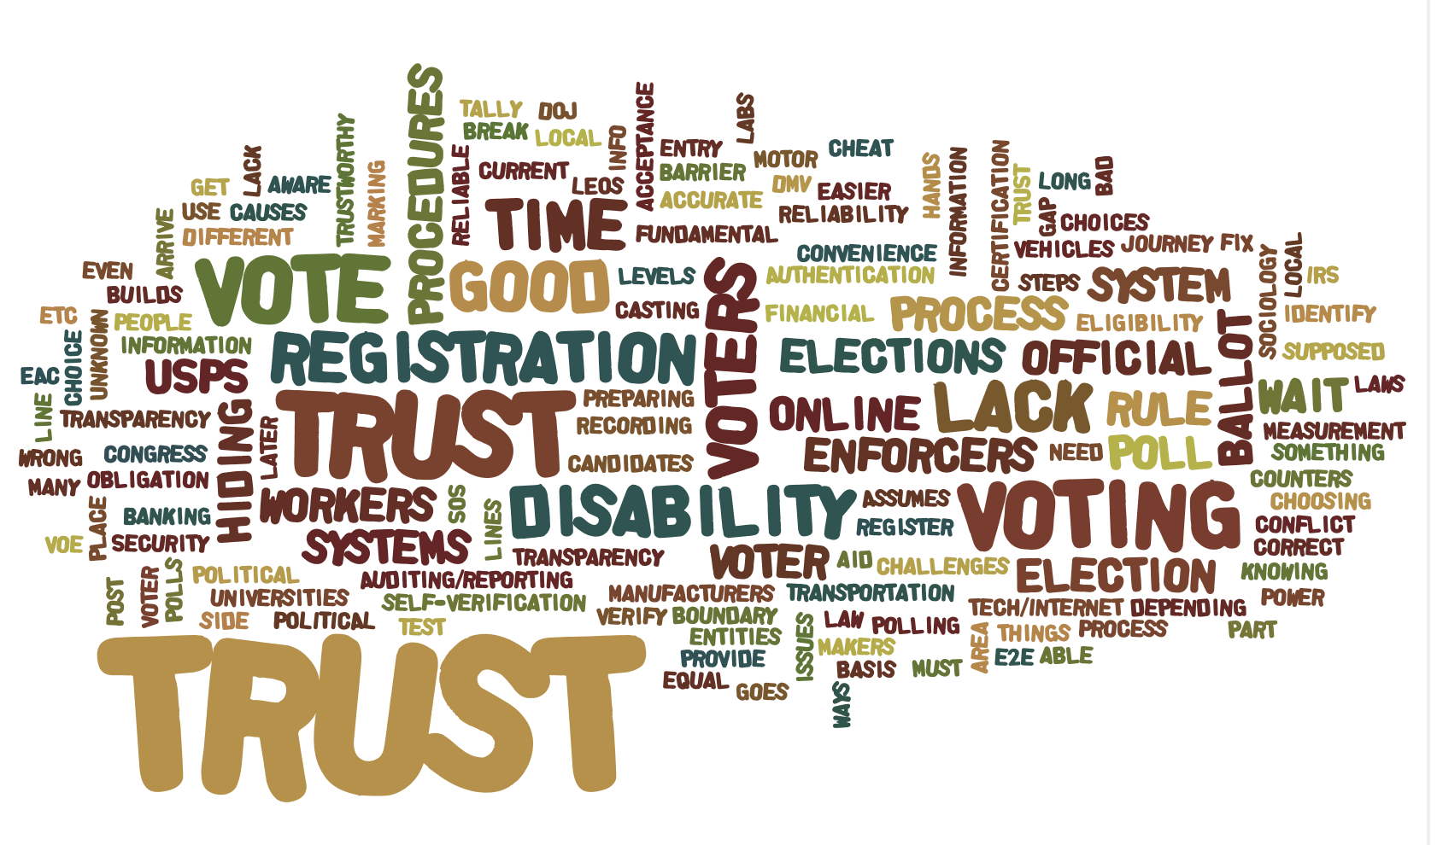
Trust, security, and verification

Slide 20
Priority topic: Trust, security, and verification
The discussion of trust, security, and verification mapped trust as an element in elections:
People
Procedures and processes
Systems
Policy and political issues
Polling places (and voting outside of them)
Information

Slide 21
Trust is based on each individual's perception of the overall process
Rule makers
Congress/ Dept of Justice
State/Local Officials
Systems approvers
EAC/Certification labs
Manufacturers
Election participants
Local Election Office
Poll workers
Helpers
Voters
Your vote counts, no matter how you vote.
The system is good. (Trust until something bad goes wrong.)
Elections are transparent and understandable.
Elections are convenient.
Reliable
Transparent
Accurate
Usable
Accessible
Consistent
(Standards)
How does voting compare to other systems?
Banking
Motor Vehicles
Financial Aid forms
IRS
US Postal Service
Policy/Political
People
Systems
TRUST
Information
Procedures
Polling Place
Easier to vote: Harder to cheat
Voter registration is accurate (your registration is actually recorded)
Voters who should vote, can. And who should not, don't.
Ballot marking, recording, tallying, auditing, reporting are correct and accurate
All procedural voting choices are equal
Knowing your choices
Knowing where to go (in person or online) and how to get there (transportation or digitally
Knowing the procedures
Knowing how to use technology
Access
- Transportation
- Accessibility
Orderly polling place
- Unknown area
- Long lines/wait time
Trustworthy people
- Willing to reveal disability?
- Give accurate information?
- Give unbiased assistance?

Slide 22
Trust in the Voter Journey
Preparing
to vote
Choosing how to vote
Checking in/
getting ballot
Marking
the ballot
Casting
the ballot
Verification
& results
Voter registration – was it actually completed?
Is the information official?
All choices are equal and votes count equally
Vote centers are backup for VoteByMail
Can I track my VBM ballot?
Authentication:
Trust in who is voting
Trust those who sholdn't vote, don't
Signature verifiation is fundamental to current laws & procedures
Election officials trust in voters
Challenges:
Unknown area
Long lines
Wait time
Lack of information
Use of tech/Internet
Is it trustworthy?
Does it do what it is supposed to do?
Does it break down?
Is the ballot accurate and complete?
Do trends ike vote early, then change our minds suggest giving up privacy?
Will my vote be cast as I intend?
Will it be counted as cast?
Which ballot counts? (Last? First?)
Recording is complete
Tally procedures are good.
Auditing/reporting is correct
Blue Sky Ideas and Resources
Identity:
Witnesses for vouching for identity
Live pilots for testing as part of certification – see it in use.
Every ballot gets scanned to the cloud: Humboldt project
Risk limiting audits
Eliminate the secret ballot
Use COTS scanning devices (like grocery scanner)
Voting equivalent to direct deposit.

Slide 23
Questions to answer for better trust
How do we decide which systems or people to trust, and who has to trust them?
Every trust change ends with a human being.
Small problems add up to decreased trust.
How do we improve trust in the political and social aspecsts of elections?
What part do election procedures play in trusting elections.
Is privacy sacred?
Are we moving towards eliminating the secret ballot?
Many online options are difficult because of the identifiation issue
How do we deal with security problems?
There are time boundaries in elections when issues can be addressed.
Elections rarely allow a "do-over."

Slide 24
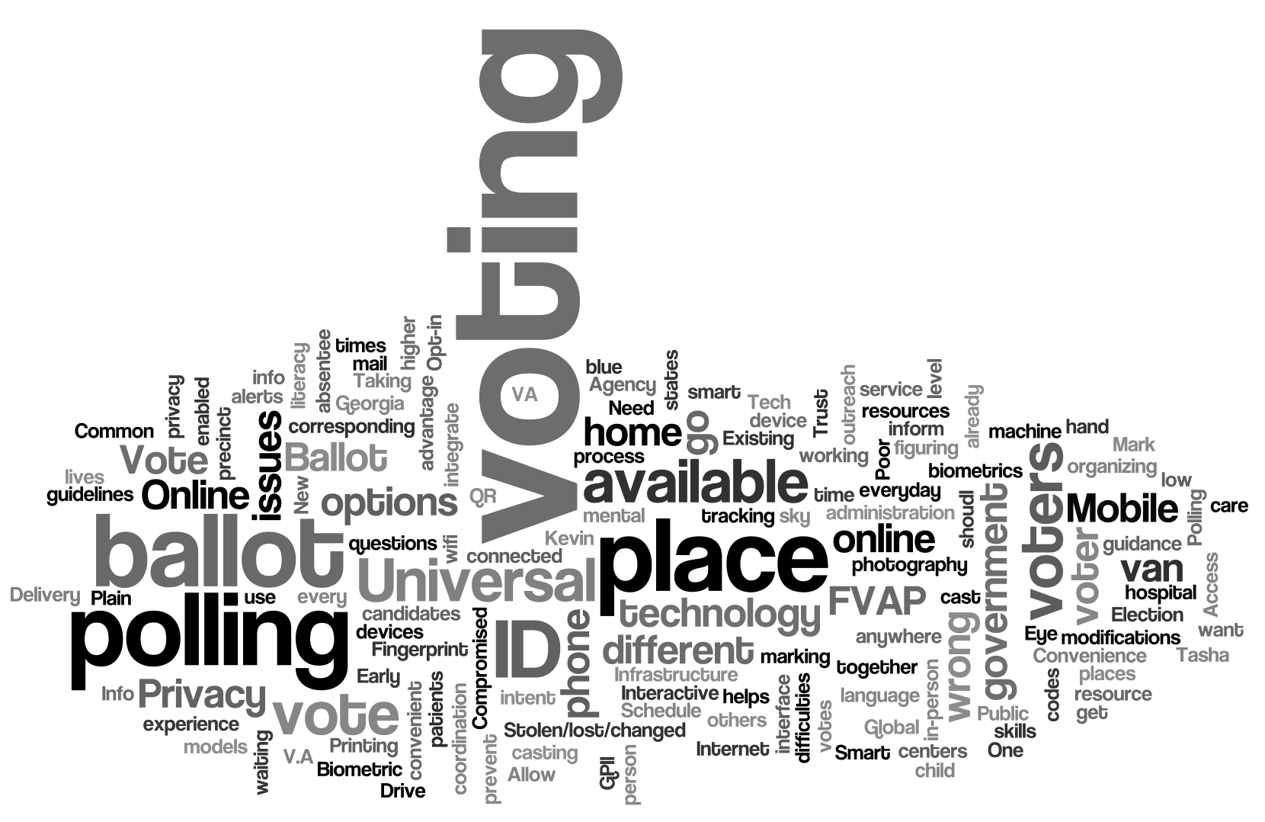
Convenience in voting

Slide 25
Priority topic: Convenience in voting
The discussion of convenience in voting and the ability to "vote anywhere" covered a wide range of issues, and what "convenience" means in this context.
One answer was to allow more personal choice, including:
When to vote
Where to vote
What systems or assistance to use

Slide 26
Voting should be the most convenient government service as voting is a right and not just a privilege.
Voters with disabilities use "convenience voting" options more than the general population. These options include:
Early voting centers
Mobile early voting vans
Vote by mail and online ballot marking
More convenient voting can expand and improve procedures and equipment already in use
Allow use of personal technology to mark ballots
Allow more flexibility in where and how to vote
Use online tools to mark and cast ballots

Slide 27
Convenience in the Voter Journey
Preparing
to vote
Choosing how to vote
Checking in/
getting ballot
Marking
the ballot
Casting
the ballot
Verification
& results
Expand and improve procedures and systems already in use
Improve voters' access to resources and information:
Hours, dates, locations
Information about candidates and measures
Finding the closest polling place.
Allow for multiple ways to vote (remote and in-person) to accommodate personal preferences and needs
Allow voting at any polling place (near work, near hoem, etc)
Bring the polling place to those who can't get there
Long term care facilities
Shut-ins
Disasters
Have voting systems support all types of personal assistive technology.
Allow voters to use their own systems at the polling place
Allow voters to mark their ballot online
Improve convenience through technolgy
Scan a QR code or other token on a pre-marked ballot
Upload a picture of a marked ballot from a smart phone
Blue Sky Ideas
SMS-based voter information for basics like election dates, hours, polling place and early voting locations
"Uber Vote" – a car service that could bring you to the polling place
This service could also extend curb-side voting to longer distances.
Voter Support Lines to help if those who have difficulty marking/casting a ballot online.
Vote by Phone to allow voters to vote anywhere at any time.
Vote via SMS – support voters who don't have smartphones.
Interactive app that uses voice search (like Siri) to let voters ask for information about their ballot of how to vote
Polling place child care
Biometics (eyescan, fingerprint) for voter identification
GPII or other ID that carries setup preferences

Slide 28
Tensions to resolve in increased convenience
How do we increase convenience without sacrificing the voter's privacy or security?
Remote voting may not be private, or may be coerced.
Serious security concerns for casting a ballot online.
How do we ensure that voters are provided with the resources and support they need to vote from anywhere?
Do we need a better organization of voter outreach and support?
Especially support for using assistive technology
Is there a conflict between personalization and equality of experience for all?
Do all voters have equal access to choice and personalization?
What is the impact of the digital divide in what kinds of personal technology (like mobile devices) people own?
How to we address differences in assistive technology?

Slide 29
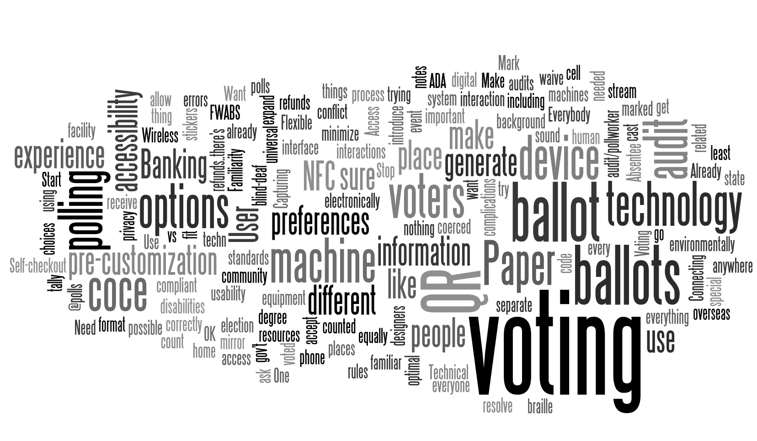
Accessibility and Universal Usability

Slide 30
Priority topic: Accessibility and Universal Usability
This topic overlapped with the discussion of convenience in voting.
How far can the goal of universal usability work when technology changes are inevitable?
How can personalization support voters in creating a more usable and accessible voting experience?
How can we use systems and interfaces that voters have already tailored for their own use?

Slide 31
Reaching universal design is a challenge when there are so many different voter needs.
Allow more personalization for individual needs and preferences.
The digital divide is a real issue: some voters do not have smartphone
Access to information, resources – not just voting.
Mobile devices are already in use for notes to prepare for voting
Optimal usability is an important step
Stop creating a separate machine for people with disabilities
We need to address e-casting, not just e-marking.
Paper ballots introduce errors, are not environmentally sound, are not ADA compliant.
Why can't we accept electronically cast ballots that we count as a separate "stream" like we do with overseas FWABS (minimize audit/pollworker complications)

Slide 32
Universal Usability in the Voter Journey (close-up view)
Preparing
to vote
Choosing how to vote
Checking in/
getting ballot
Marking
the ballot
Casting
the ballot
Verification
& results
Ensure equal access to all parts of the voter journey
for all, even without personalization or individual technology
Resources
Existing standards – WCAG 2.0, Section 508
NFC or QR codes
NFC or QR codes
Mobile phones are important as a way to bring a marked sample ballot to the polling place (but not always allowed)
Need to include technology like Braille [preferred by some, critical for deaf-blind)
Separate "stream" for electronically cast ballots

Slide 33
Thoughts about universal usability
Can standards and solutions for voting expand to all government related interactions?
Capturing preferences could extend to all interactions
Consistency is more important for AT users and those with challenges
Can one size fit all?
We have to consider voters who arrive at the polls with no AT
Should the system be modular with alternatives for different needs?
Can the system be flexible with different interaction options?
How do we deal with differences between jurisdictions?
Every state has different rules – what is the common denominator?

Slide 34
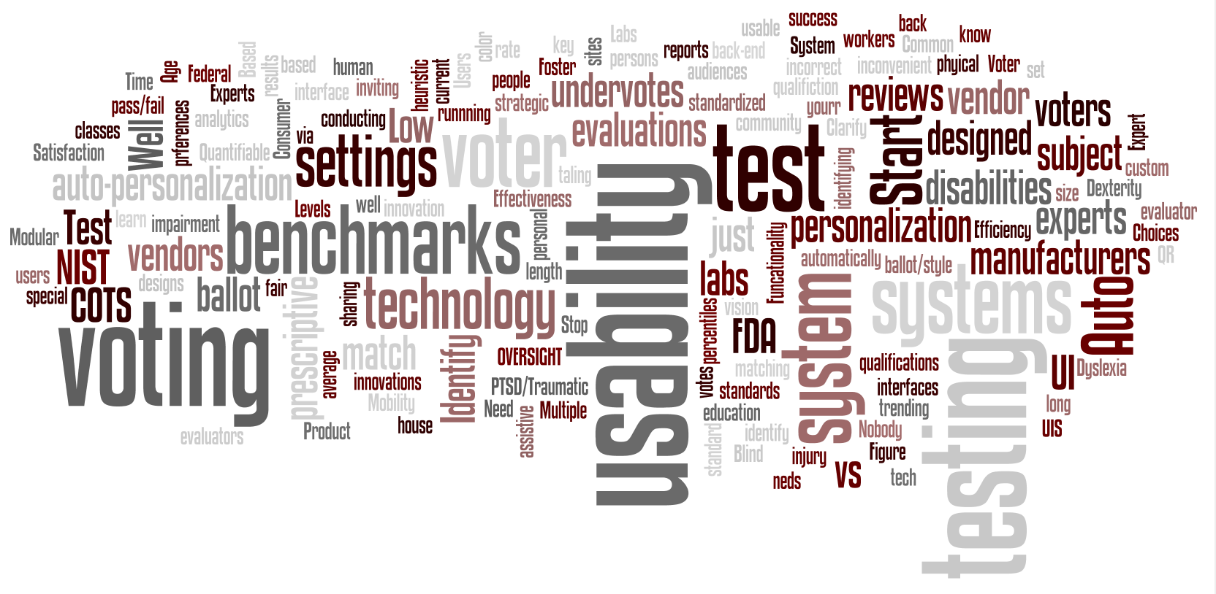
Design and Evaluation

Slide 35
Priority topic: Design and evaluation
Discussion of design and evaluation included:
Design and development processes that encourage good usability and accessibility.
Ways to write guidance for best practices, standards, and test methods.
Different test approaches and how they might fit into the certification process.

Slide 36
Design and Evaluations supports the voter journey
Writing Guidance
Testing Approaches
Certification Process
Challenges
Resources
US Constitution
EAC and NIST limited to voting systems. WIll the EAC be able to change directions?
Standards are too absolute
A "testing standard" has become a "design standard"
High level vs. detailed requirements
Cost of iterative design/feedback loop+ certifiction
Until voters actually vote on the machine, there is not way to know it will work
We test voting systems, but not other parts of the election system
2018/2020 and the impending crisis of out-of-date systems
Guiding principles that reach for an outcome
Usability standards based on efficiency, effectiveness, satisfaction
What technique tells you what
Classify voters not systems
Involve a broad group of election officials in generating standards
Testing with hardest, not easiest, users
Create a voter expo for combined testing days to make it easier to assemble a large and diverse group of voters as test participants.
Design iterations and testing
Attractive and simple ballot that is used by everyone
Benefits of certification: license to use
Procurement intersects with certification to force procedures and decisionmaking
EAC doing federal and state certification at the same time
Piloting at different levels
Better feedback on the outcomes of systems in use
Practice voting and testing constantly
Consumer reports for voting sysems
Vendor review website (Yelp for voting systems)
Common/shared user data to create better voting systems
Existing standards
WCAG 2.0, Section 508
IEEE common data format for reporting/log files
Industry standards
Slot machine certifcation
Bank audits
FDA
FAA Declaration of Conformance
Committees
NASED
State Certification Group

Slide 37
A concept for useful guidance in the right form
Continued monitoring and feedback (from the formal to informal) allows regular review of both the goals and the guidance.
Monitoring and feedback in use
Voter scenarios illustrate the guidelines in action, helping meet the goals.
Samples show design and code best practices.
Testing and evaluation methods inform the design of systems.
Training supports those new to the field and continued learning.
Training
Testing and Evaluation
Samples & Examples
Voter Scenarios
System-Specific Guidelines
by type of election system
The system-specific guidlines extend the core rules for types of systems, such as:
Informational websites
Interactive web features
ePoll books
Voting systems
Election management systems
Core Usability & Accessibility Knowledge and Guidance
Test Methods
The Core Requirements are testable usability basics that apply to any interactive system.
Goals
Clear statments of goals help everyone understand the reason for any requirement or guidelines.
Notes:
Diagram showing the guidance stack. From the bottom:GoalsGeneral guidelinesSystem specific guideliensTraining, Testing and Evaluation, Samples and Examples, Voter scenariosMonitoring and feeback in use

